Slide 1
BMW
Twitter Brand Performance Report
01 May 2022 - 31 May 2022

Slide 2
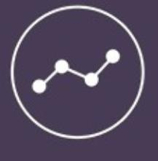
Report
Content
Overview
4
Follower Analysis
7
Growth Statistics
10
Post Analysis
13
Best Posts
19
Engagement Performance
26
Comparison with Industry
33
The statistics from this analysis were taken from the publicly-open data shared by Twitter. All rights of this analysis belongs to TTBOOM Dijital İnteraktif Medya A.Ş.
This analysis cannot be copied, published or distributed completely or partially without permission.
2

Slide 3
About
BoomSocial
Social Media Measurement
BoomSocial Analyses
BoomSocial is a social media measurement, reporting and analytic platform that offers insights for brands to develop their online communication strategies.
The platform monitors thousands of brand pages and accounts, company pages and channels on Facebook, Twitter, Google+, YouTube and Instagram.
BoomSocial helps you measure social media performance for your brand and competitors, analyze interactions of your industry, and improve your online strategy.
BoomSocial Premium Reports and Analyses help you to analyze and report on the social media performance of your industry, brand and competitors. The analyses create value for you by providing insights that will enhance your brand's social media content and marketing strategies. All analyzes are prepared in Microsoft PowerPoint format, which allows you to transfer slides to your own presentations.
You can buy specific analysis of sectors and brands on social media channels online.
Click now to buy BoomSocial analyses of your brand & industry:
http://bit.ly/BoomSocialPremiumAnalyses
3

Slide 4
Overview
The overview of BMW Twitter account, followers, growth, posts and engagement in 01 May 2022 - 31 May 2022 period.
2.4M
246
15K
Total Followers
Total Posts
Total Engagement
The number of follower for the page has reached 2,376,715 on 31.05.2022. The page has gained 18,042 follower, and page follower increased by -0.759%.
A total of 246 posts were shared on account in 01.05.2022 – 31.05.2022 period. The most used post type is text, with 196 posts.
The page in 01.05.2022 – 31.05.2022 period have received 13,736 likes and 1,738 retweets.
4

Slide 5
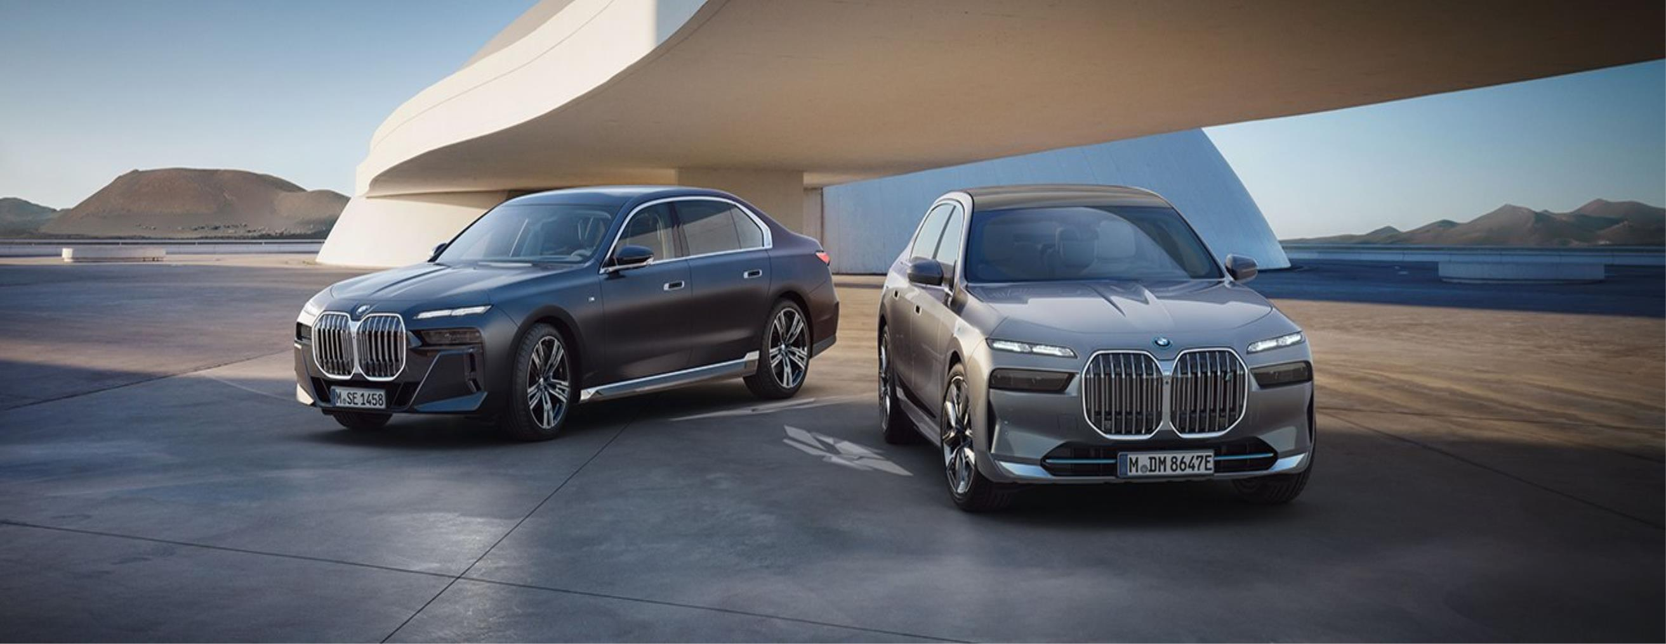
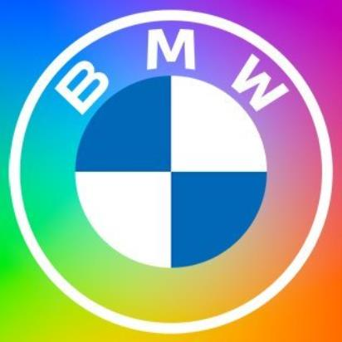
Overview
Page Summary
01.05.2022 - 31.05.2022
BMW
http://twitter.com/BMW
Overview
Followers Count
BMW Twitter account in Germany > Automotive > Manufacturers has gained 18,042 follower, and changed from 2,358,673 to 2,376,715 follower in 01.05.2022 - 31.05.2022 period.
During this period, the page has shared 246 posts and received 13,736 likes and 1,738 retweets.
5

Slide 6
Follower Analysis
The fan analysis of BMW Twitter account for Followers, Follower Growth and Industry leaders in 01 May 2022 - 31 May 2022 period.
2.4M
18K
%0.76
Total Followers
Total Follower Change
Change Rate of Followers
The total number of followers of the account on 31.05.2022 was 2,376,715.
The page has gained 18,042 follower in 01.05.2022 - 31.05.2022 period.
Total followers of the account increased by 0.759% in 01.05.2022 - 31.05.2022.
6

Slide 7
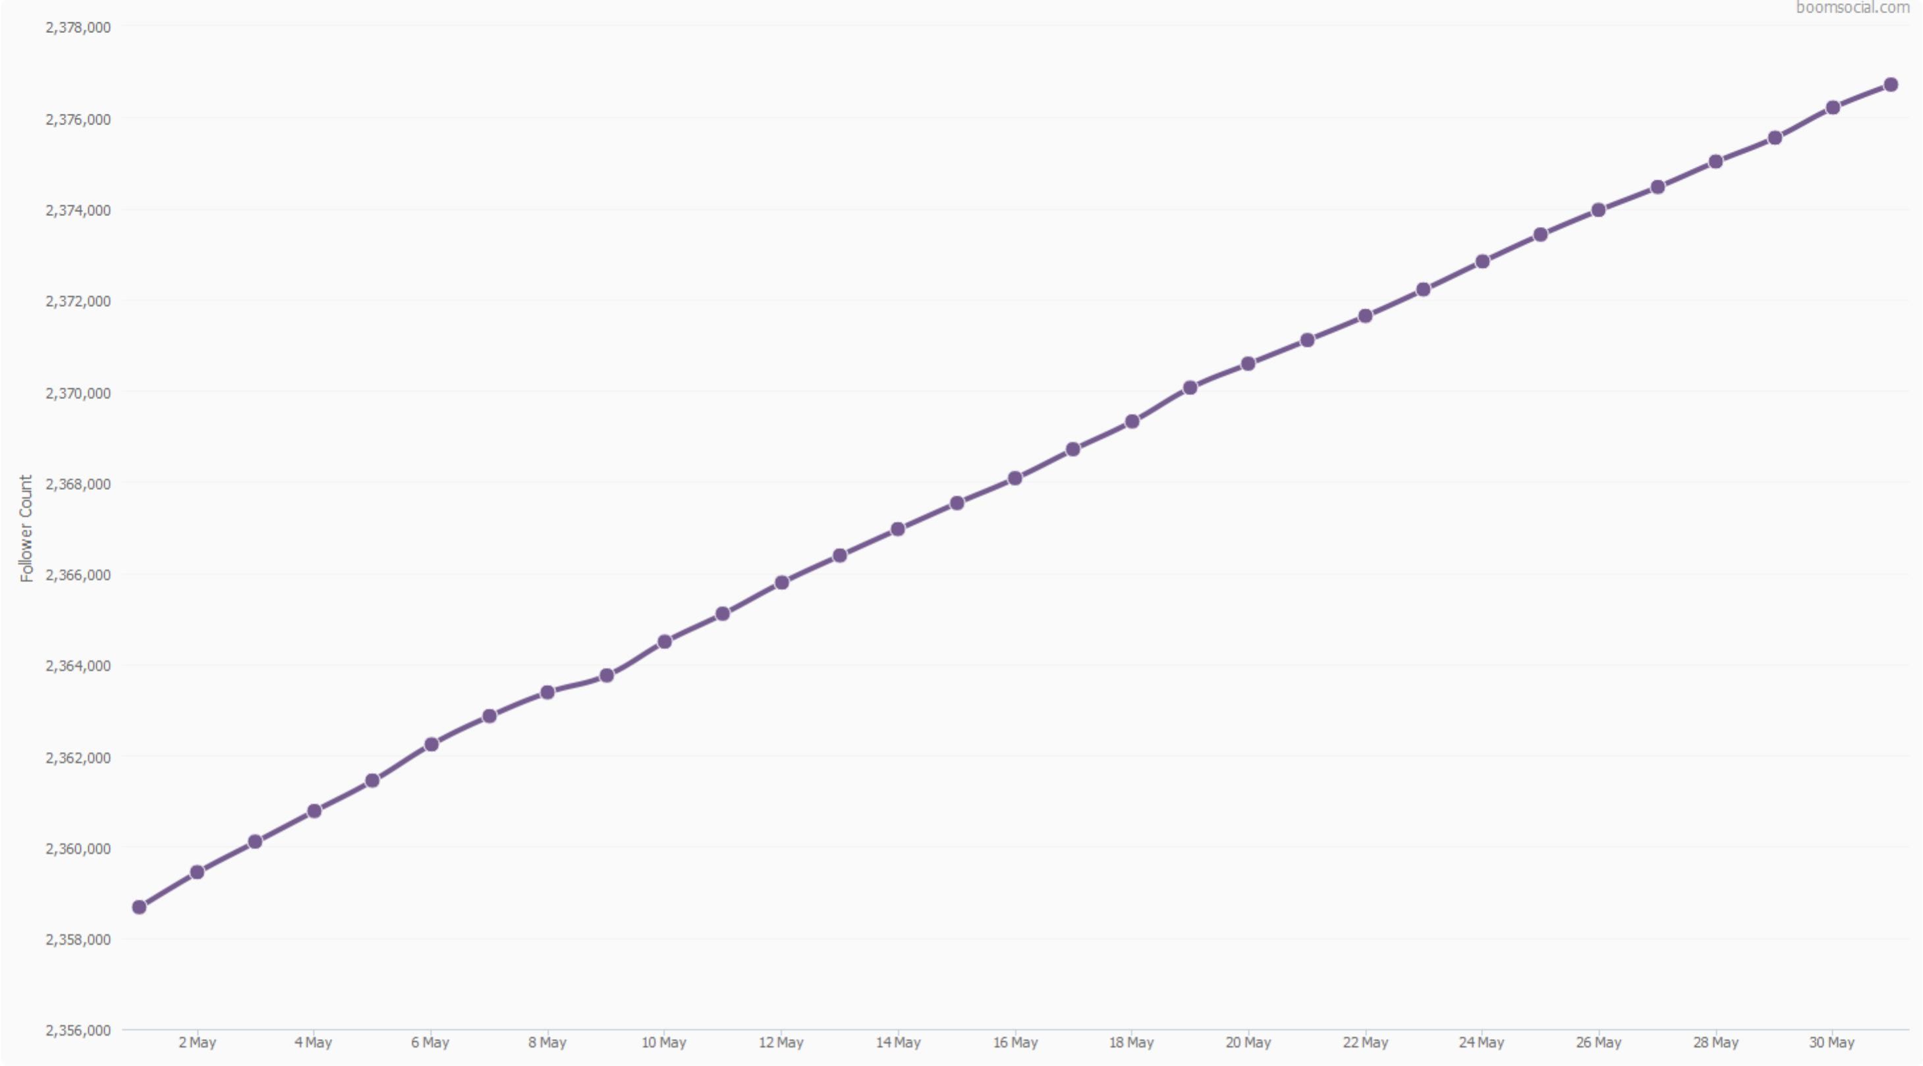
Follower Analysis
Follower Performance
01.05.2022 - 31.05.2022
Page Followers by Days
2,376,715
Total Followers of the Account
31.05.2022
18,042
Total Follower Change
01.05.2022 - 31.05.2022
0.76%
Total Follower Change Rate
01.05.2022 - 31.05.2022
7

Slide 8
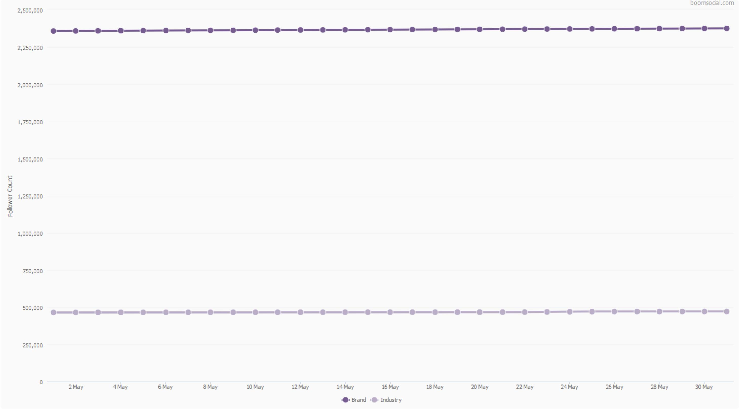
Follower Analysis
Follower Performance vs Industry
01.05.2022 - 31.05.2022
Brand and Industry Follower Counts:
Germany > Automotive > Manufacturers
In 24 Pages
2
On 31.05.2022, BMW was the 2. most followed page between the 24 pages in Automotive – Manufacturers industry.
Compared to Industry Average
403%
more follower
The number of fans of the page is 403% more than the industry average.
8

Slide 9
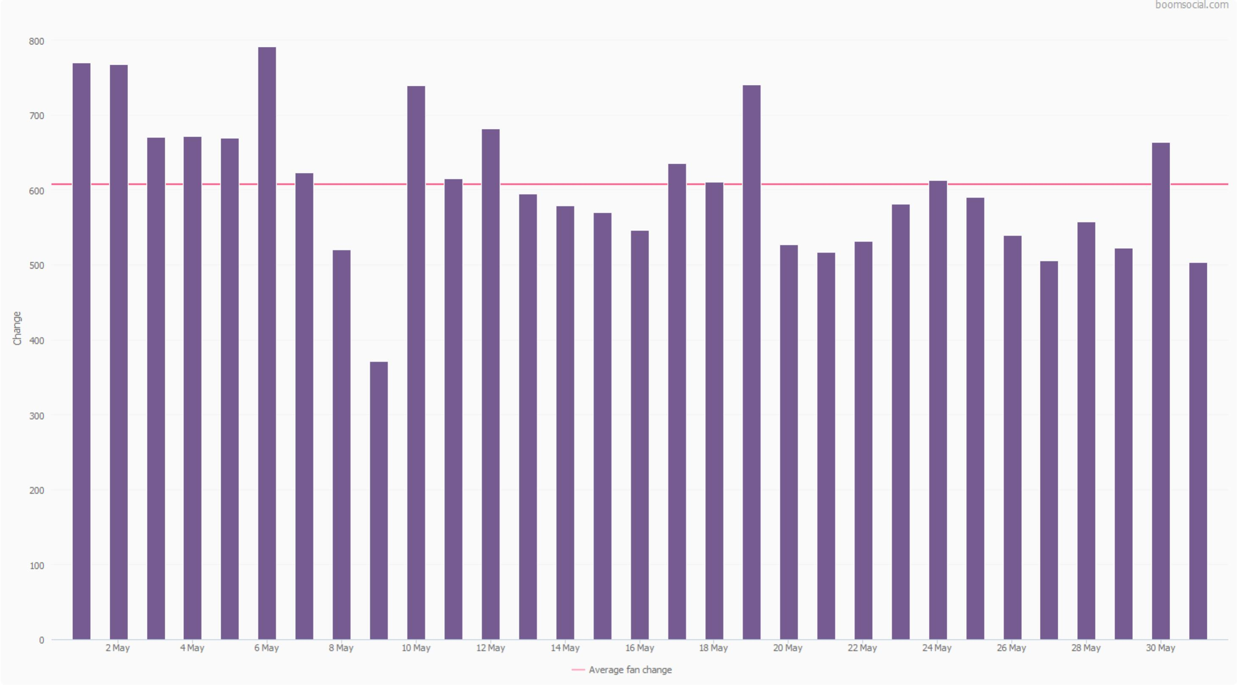
Follower Analysis
Follower Growth
01.05.2022 - 31.05.2022
BMW Follower Growth by Days
18,042
Follower Change of the Account
01.05.2022 - 31.05.2022
0.76%
Rate of Change for the Account
01.05.2022 - 31.05.2022
1.40%
Rate of Change for the Industry
01.05.2022 - 31.05.2022
9

Slide 10
Follower Analysis
Follower Growth vs Industry
01.05.2022 - 31.05.2022
Follower Growth by Days for the BMW Twitter Account
In 24 Pages
4
On 31.05.2022, BMW was the 4. in growth between the 24 pages in Automotive – Manufacturers industry.
Average Follower Growth by Days for Automotive > Manufacturers
1.40%
Rate of Change for the Industry
01.05.2022 - 31.05.2022
10

Slide 11
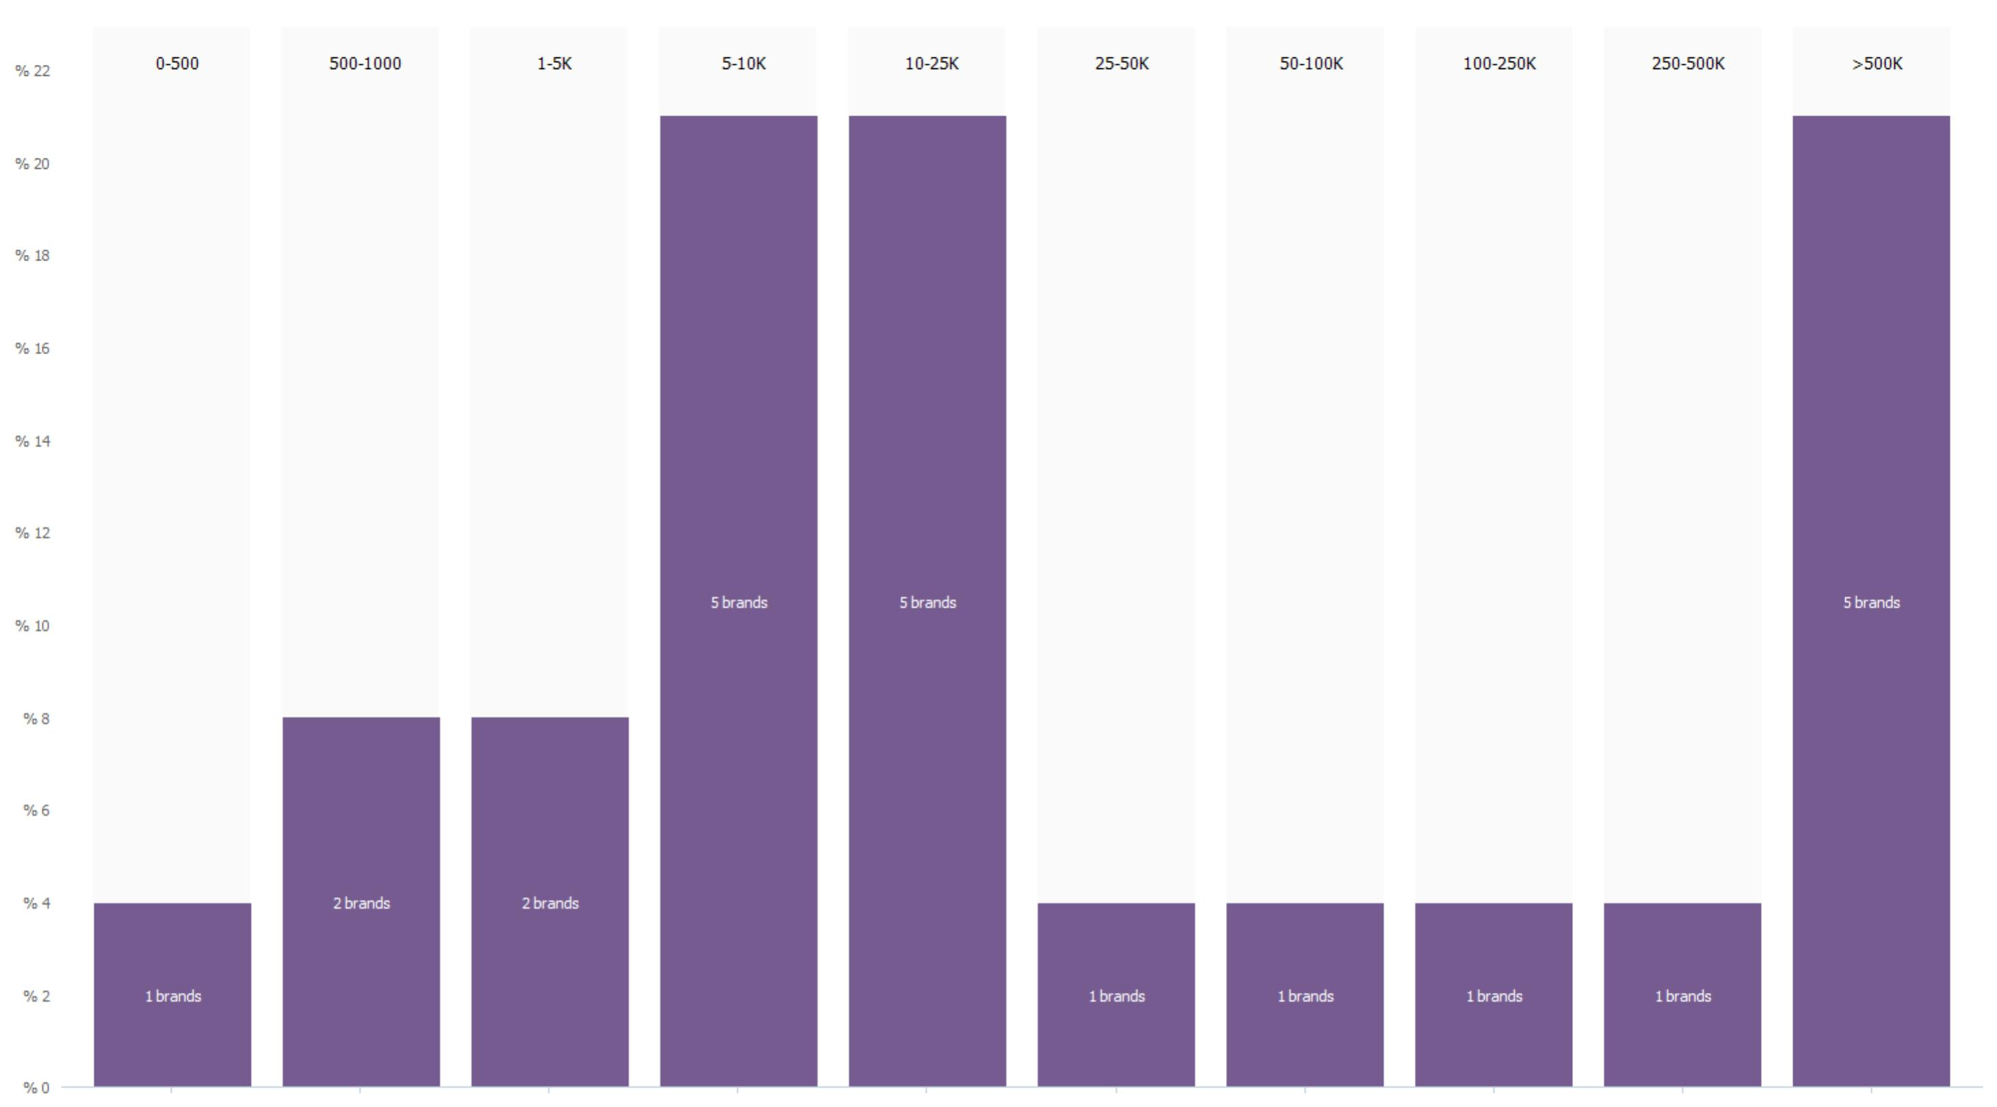
Follower Analysis
Follower Counts of Industry
01.05.2022 - 31.05.2022
Accounts in the Twitter Automotive > Manufacturers Industry by Follower Counts
24
Number of Brands in the Industry
31.05.2022
2,376,715
Follower Count of the Brand
31.05.2022
472,089
Average Follower Count of Industry
31.05.2022
11

Slide 12
Post Analysis
The page posts analysis of BMW Twitter account for post counts, post types, post sharing patterns and comparison to the industry in 01 May 2022 - 31 May 2022 period.
246
13
5
Total Posts
Photos
Videos
The page has shared 246 different posts in 01.05.2022 - 31.05.2022 period.
The page has shared 13 Photo posts on the page wall in 01.05.2022 – 31.05.2022.
The page has shared 5 Video posts on the page wall in 01.05.2022 – 31.05.2022.
12

Slide 13
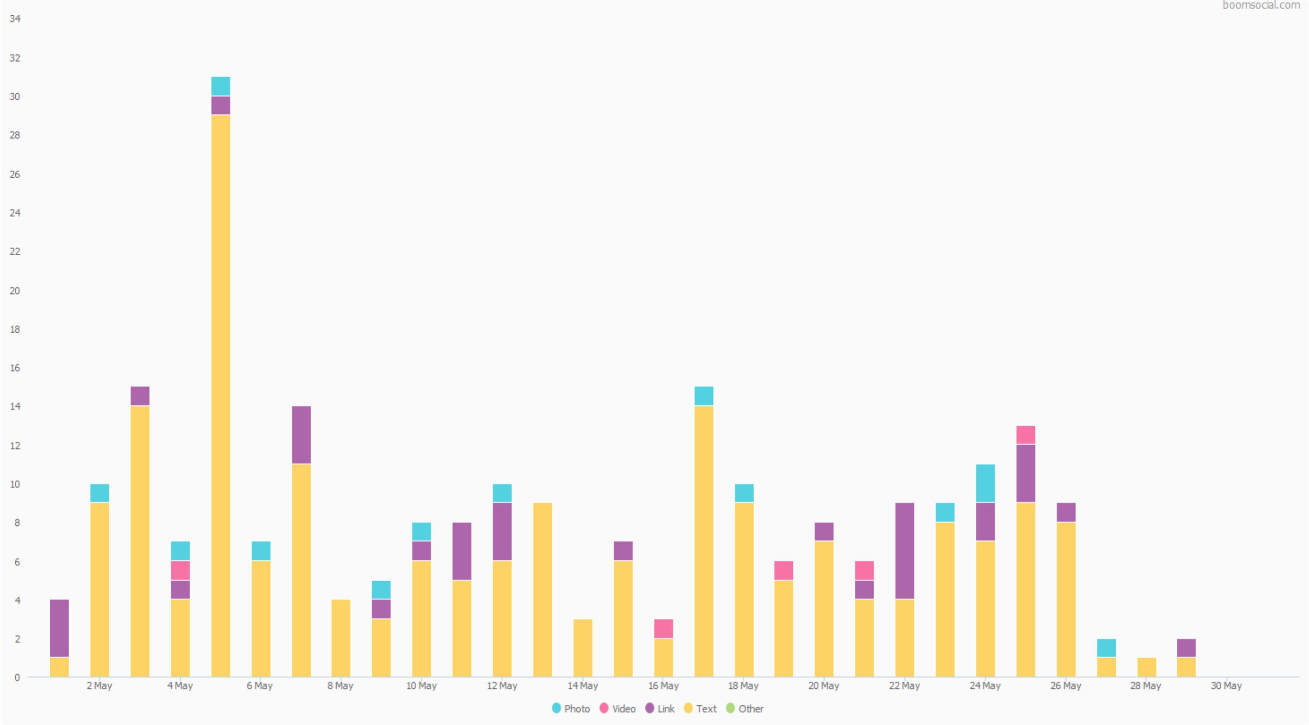
Post Analysis
Posts
01.05.2022 – 31.05.2022
Page Posts by Day
13
Photo
5
Video
32
Link
196
Text
0
Other
13

Slide 14
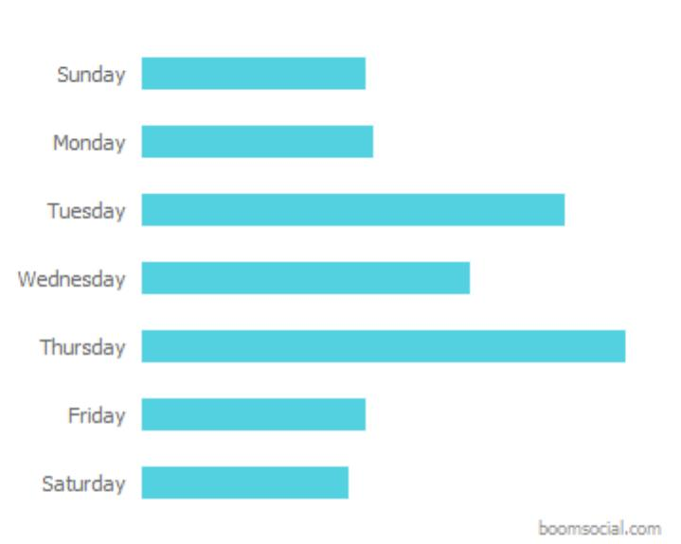
Post Analysis
Post Time Analysis
01.05.2022 – 31.05.2022
Posts by Days and Hours
14.00
Most Active Hours
01.05.2022 – 31.05.2022
Posts by Hours
Posts by Weekdays
Thursday
Most Active Day
01.05.2022 – 31.05.2022
14

Slide 15
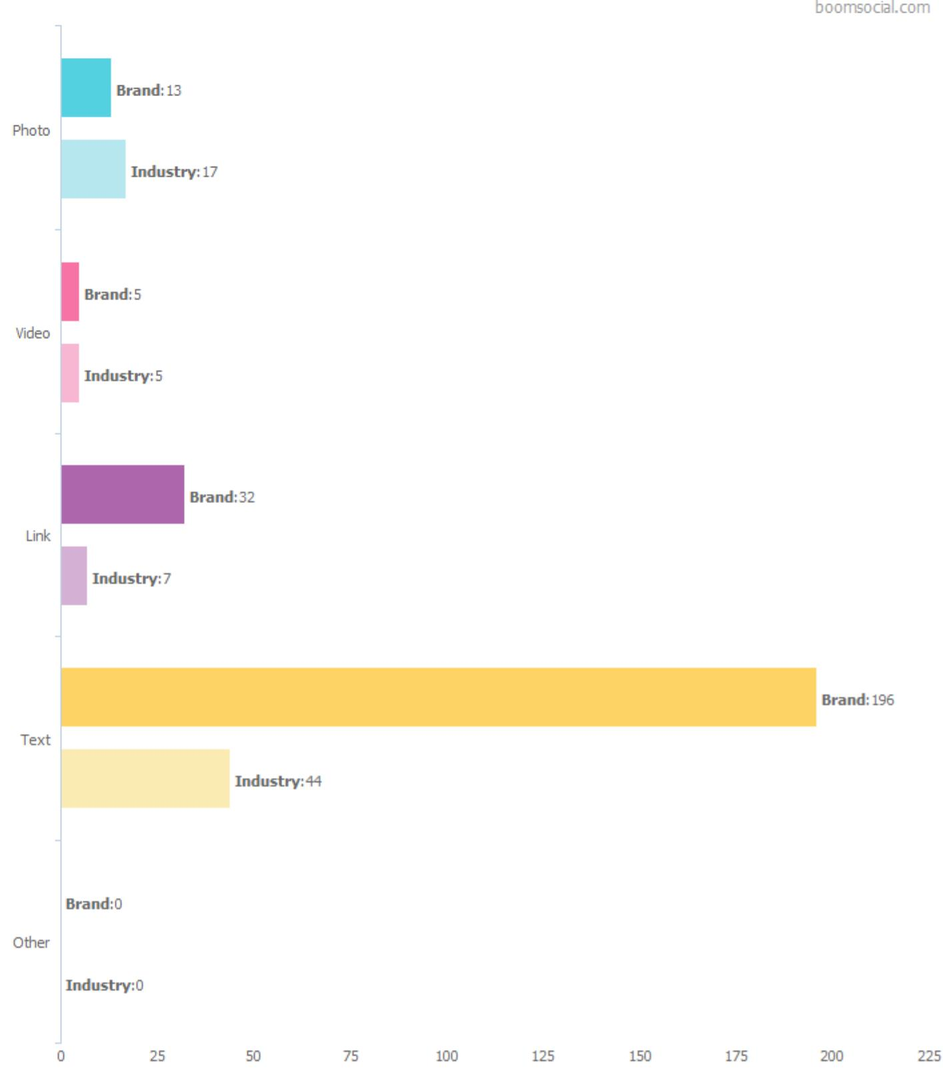
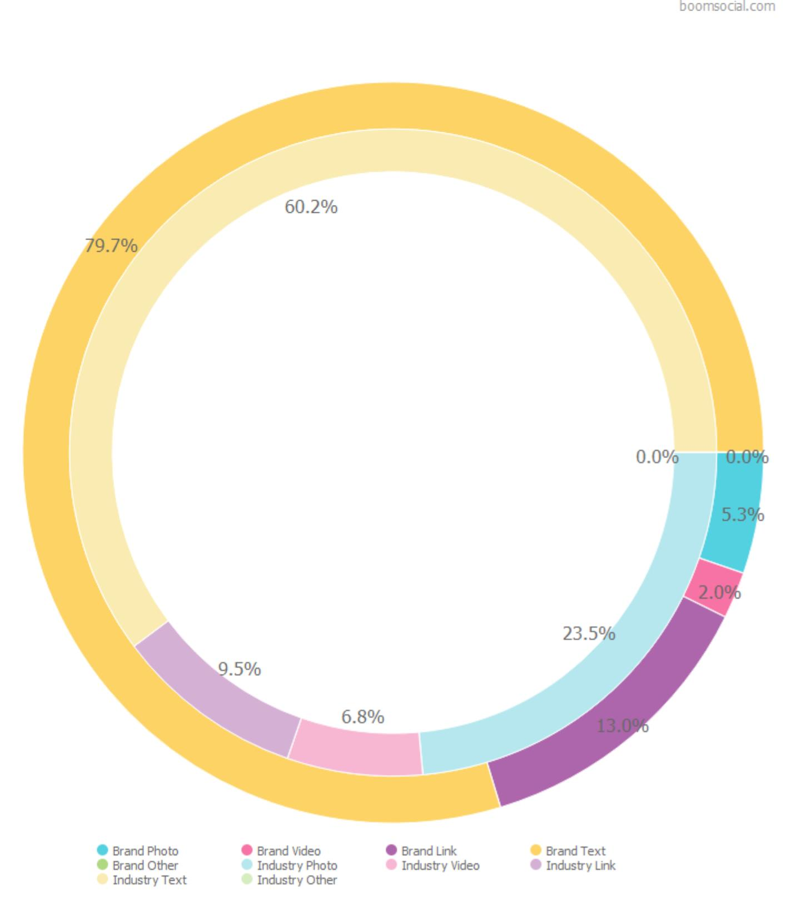
Post Analysis
Post Types
01.05.2022 – 31.05.2022
Use of Post Types: Brand vs Industry
Post Types
246
Total Posts
of the Brand
8.2
Average Posts per Day
for the Brand
73.6
Average Post Count
of the Industry
2.5
Average Posts per Day
for the Industry
15

Slide 16
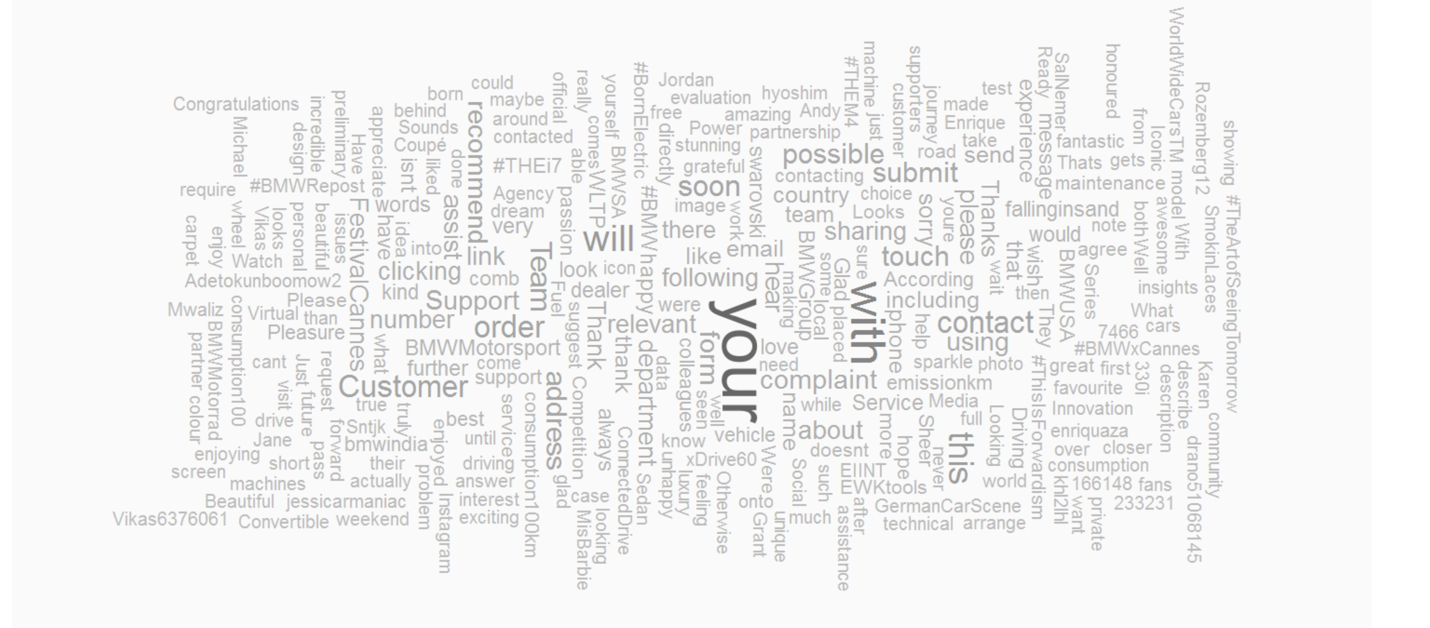
Post Analysis
Word Cloud
01.05.2022 – 31.05.2022
Most Used Words in the Posts
16

Slide 17
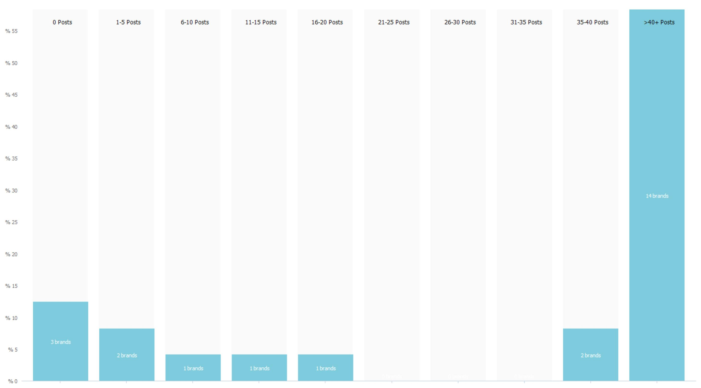
Post Analysis
Posting Frequency of Industry
01.05.2022 – 31.05.2022
Pages in the Industry by Monthly Post Averages
246
Monthly Post Average
for the Brand
01.05.2022 – 31.05.2022
74
Monthly Post Average
for the Industry
01.05.2022 – 31.05.2022
Each range shows the number of brands which have 30-day average post counts between the limits. Values are adjusted for 30-day period.
17

Slide 18
Top Posts
The top posts analysis of BMW Twitter account for the most engaging posts, engagement rates, and engagement patterns in 01.05.2022 – 31.05.2022 period.
246
15K
%68.6
Total Posts
Total Engagement
Engagement Share of Top 10
The page has shared 246 posts on the wall in 01.05.2022 – 31.05.2022 period.
Page posts has received a total of 15,474 engagements in 01.05.2022 – 31.05.2022 period.
Top 10 most engaged posts has received 0.00% of all engagements in 01.05.2022 – 31.05.2022 period.
18

Slide 19
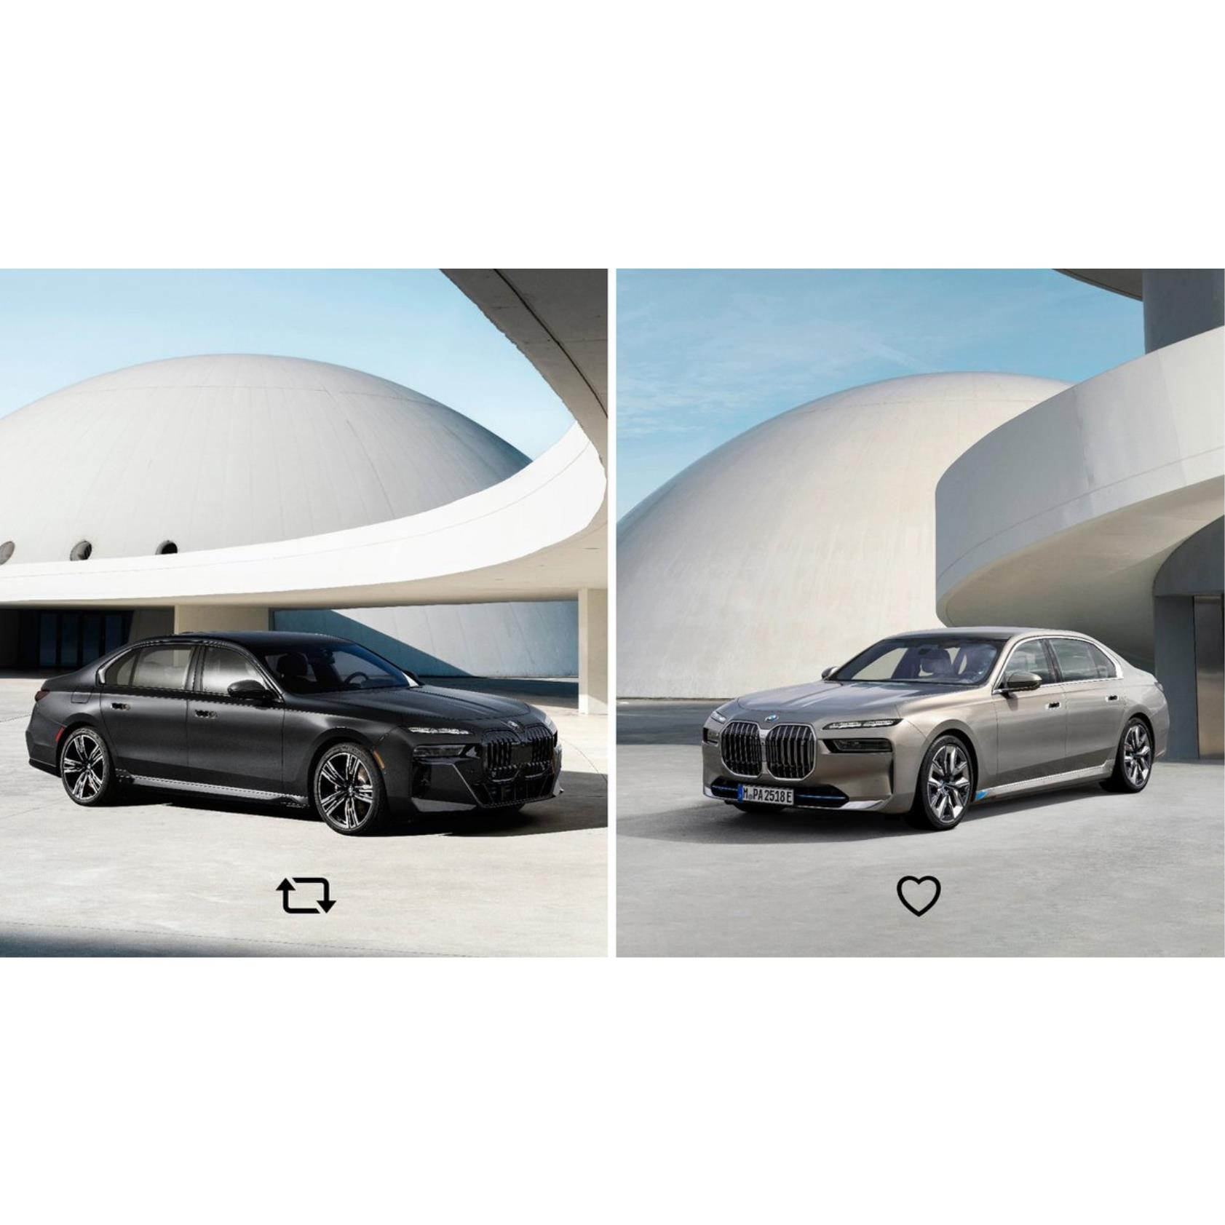
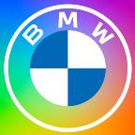
Top Posts
Most Engaged Posts
01.05.2022 – 31.05.2022
BMW
04 May 2022 18:22
http://www.twitter.com/BMW/status/1521872877452242944
Choose your side.
#MayThe4thBeWithYou pic.twitter.com/nTaOXma3nc
Like
1,834
Retweet
295
Engagement Rate
%0.128
19

Slide 20
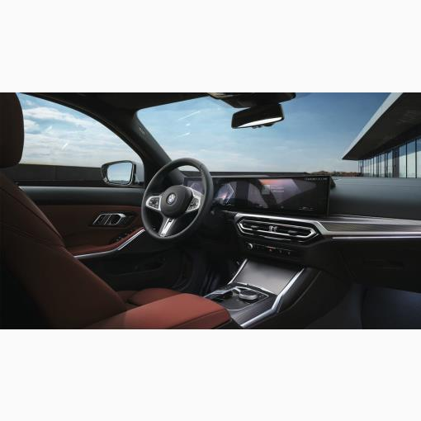
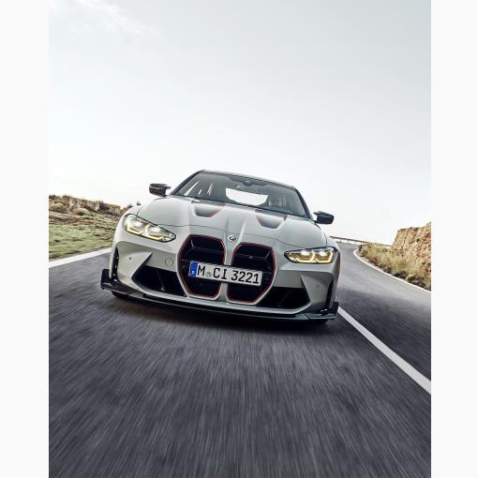
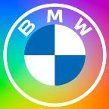
Top Posts
Most Engaged Posts
01.05.2022 – 31.05.2022
BMW
BMW
BMW
18 May 2022 10:30
16 May 2022 22:47
24 May 2022 19:52
The new BMW 3 Series. With BMW Curved Display and revised touch-control surfaces, for a digitally enhanced focus on the love of driving.
The #BMW 330i Sedan:
Fuel consumption/100km, CO2 emission/km comb.: 7.4–6.6 l, 166–148 g. According to WLTP, ...
Coming soon. The new #BMW 3 Series. #THE3 pic.twitter.com/ZkMyrgYDnk
The new M4 CSL in numbers ⏬
550hp
3.7s - 0-100 km/h
10.7 - 0-200 km/h
+ 40hp over M4 Competition Coupé
100kg less than the M4 Competition Coupé
...
http://www.twitter.com/BMW/status/1526827432656965632
http://www.twitter.com/BMW/status/1526288156982657026
http://www.twitter.com/BMW/status/1529143191936581632
Like
1,105
Like
993
Like
915
Retweet
141
Retweet
146
Retweet
126
Engagement Rate
%0.070
Engagement Rate
%0.067
Engagement Rate
%0.060
20

Slide 21
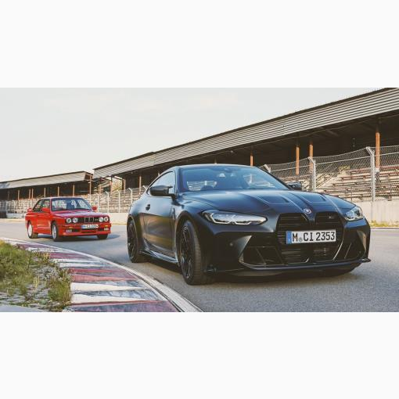
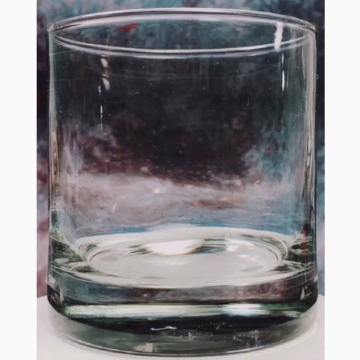
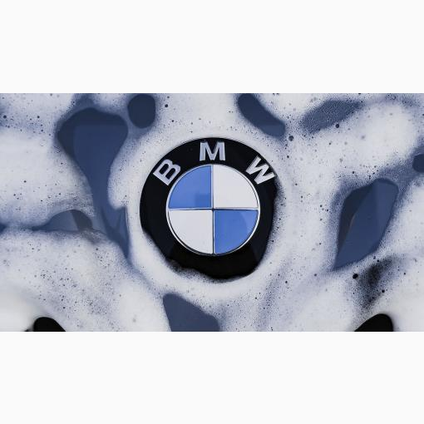
Top Posts
Most Engaged Posts
01.05.2022 – 31.05.2022
BMW
BMW
BMW
06 May 2022 14:12
04 May 2022 17:31
12 May 2022 16:05
Pure power with a personal touch.
The limited edition BMW M4 Competition Coupé x KITH.
#THEM4
__
The #BMW M4 Competition Coupé:
Fuel consumption/100km, CO2 emission/km comb.: 9.8 l, 224–223 g. According to WLTP, https://t.co/twXzMrWMl3 . ...
#BMW 💕 #BMWRepost t @fallinginsand d pic.twitter.com/zsm9hq7Jf5 5
Anyone else love that post car wash sparkle? 🤩 #BMW W #BMWRepost t koloskovacs on Instagram: pic.twitter.com/5PiBg1VDib b
http://www.twitter.com/BMW/status/1522534684521111557
http://www.twitter.com/BMW/status/1521860118127824902
http://www.twitter.com/BMW/status/1524737411216990208
Like
890
Like
879
Like
781
Retweet
128
Retweet
111
Retweet
78
Engagement Rate
%0.059
Engagement Rate
%0.056
Engagement Rate
%0.046
21

Slide 22
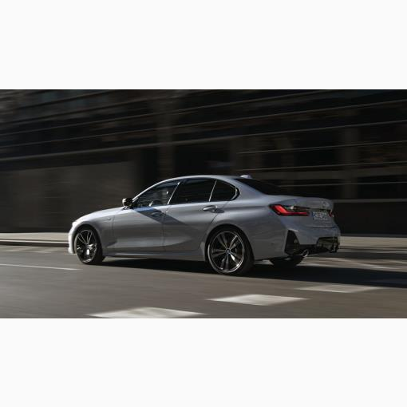
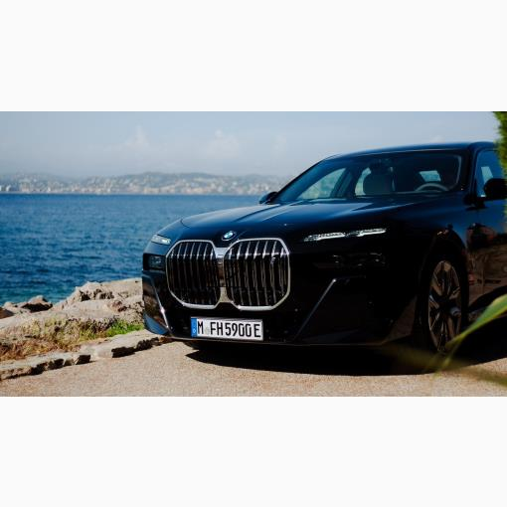
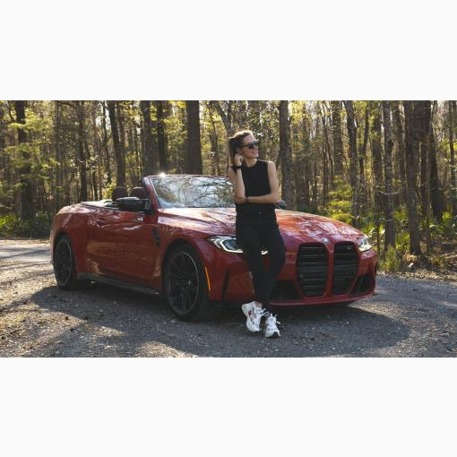
Top Posts
Most Engaged Posts
01.05.2022 – 31.05.2022
BMW
BMW
BMW
23 May 2022 16:00
17 May 2022 20:25
02 May 2022 12:32
The new BMW 3 Series. A long history of progress has never looked so refined.
The #BMW 330i Sedan:
Fuel consumption/100km, CO2 emission/km comb.: 7.4–6.6 l, 166–148 g. According to WLTP, https://t.co/twXzMrWMl3 pic.twitter.com/Wb9PNfxJLK
An icon born for the big screen The new i7 on the road in partnership with @Festival_Cannes
#THEi7 #BornElectric #ThisIsForwardism #BMWxCannes #TheArtofSeeingTomorrow pic.twitter.com/Ch0L1kPw3M
Ready for my weekend getaway ✌🏼
The BMW M4 Competition Convertible. #THEM4 4 #BMW W #BMWRepost t @jessicarmaniac c
__
Fuel consumption/100km, CO2 emission/km comb.: 10.2 l, 233–231 g. According to WLTP, https://t.co/twXzMrWMl3 3. pic.twitter.com/uWmkzKC2Yn...
http://www.twitter.com/BMW/status/1528722418826715140
http://www.twitter.com/BMW/status/1526614781351940097
http://www.twitter.com/BMW/status/1521060150274048000
Like
666
Like
663
Like
649
Retweet
77
Retweet
71
Retweet
62
Engagement Rate
%0.041
Engagement Rate
%0.040
Engagement Rate
%0.038
22

Slide 23
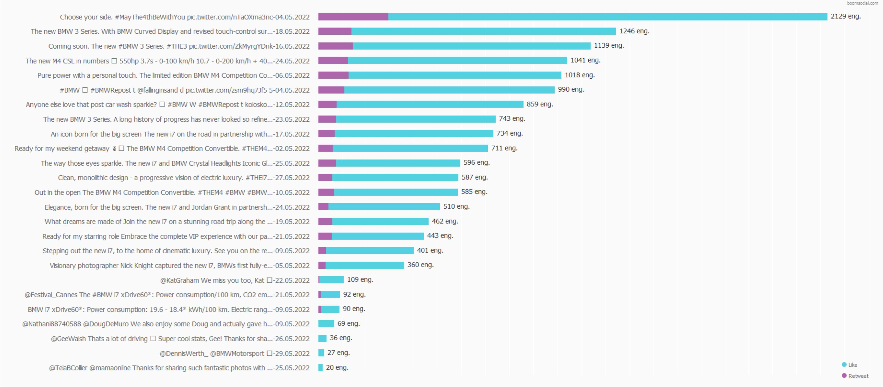
Top Posts
Post Performance
01.05.2022 – 31.05.2022
Most Engaging Posts
23

Slide 24
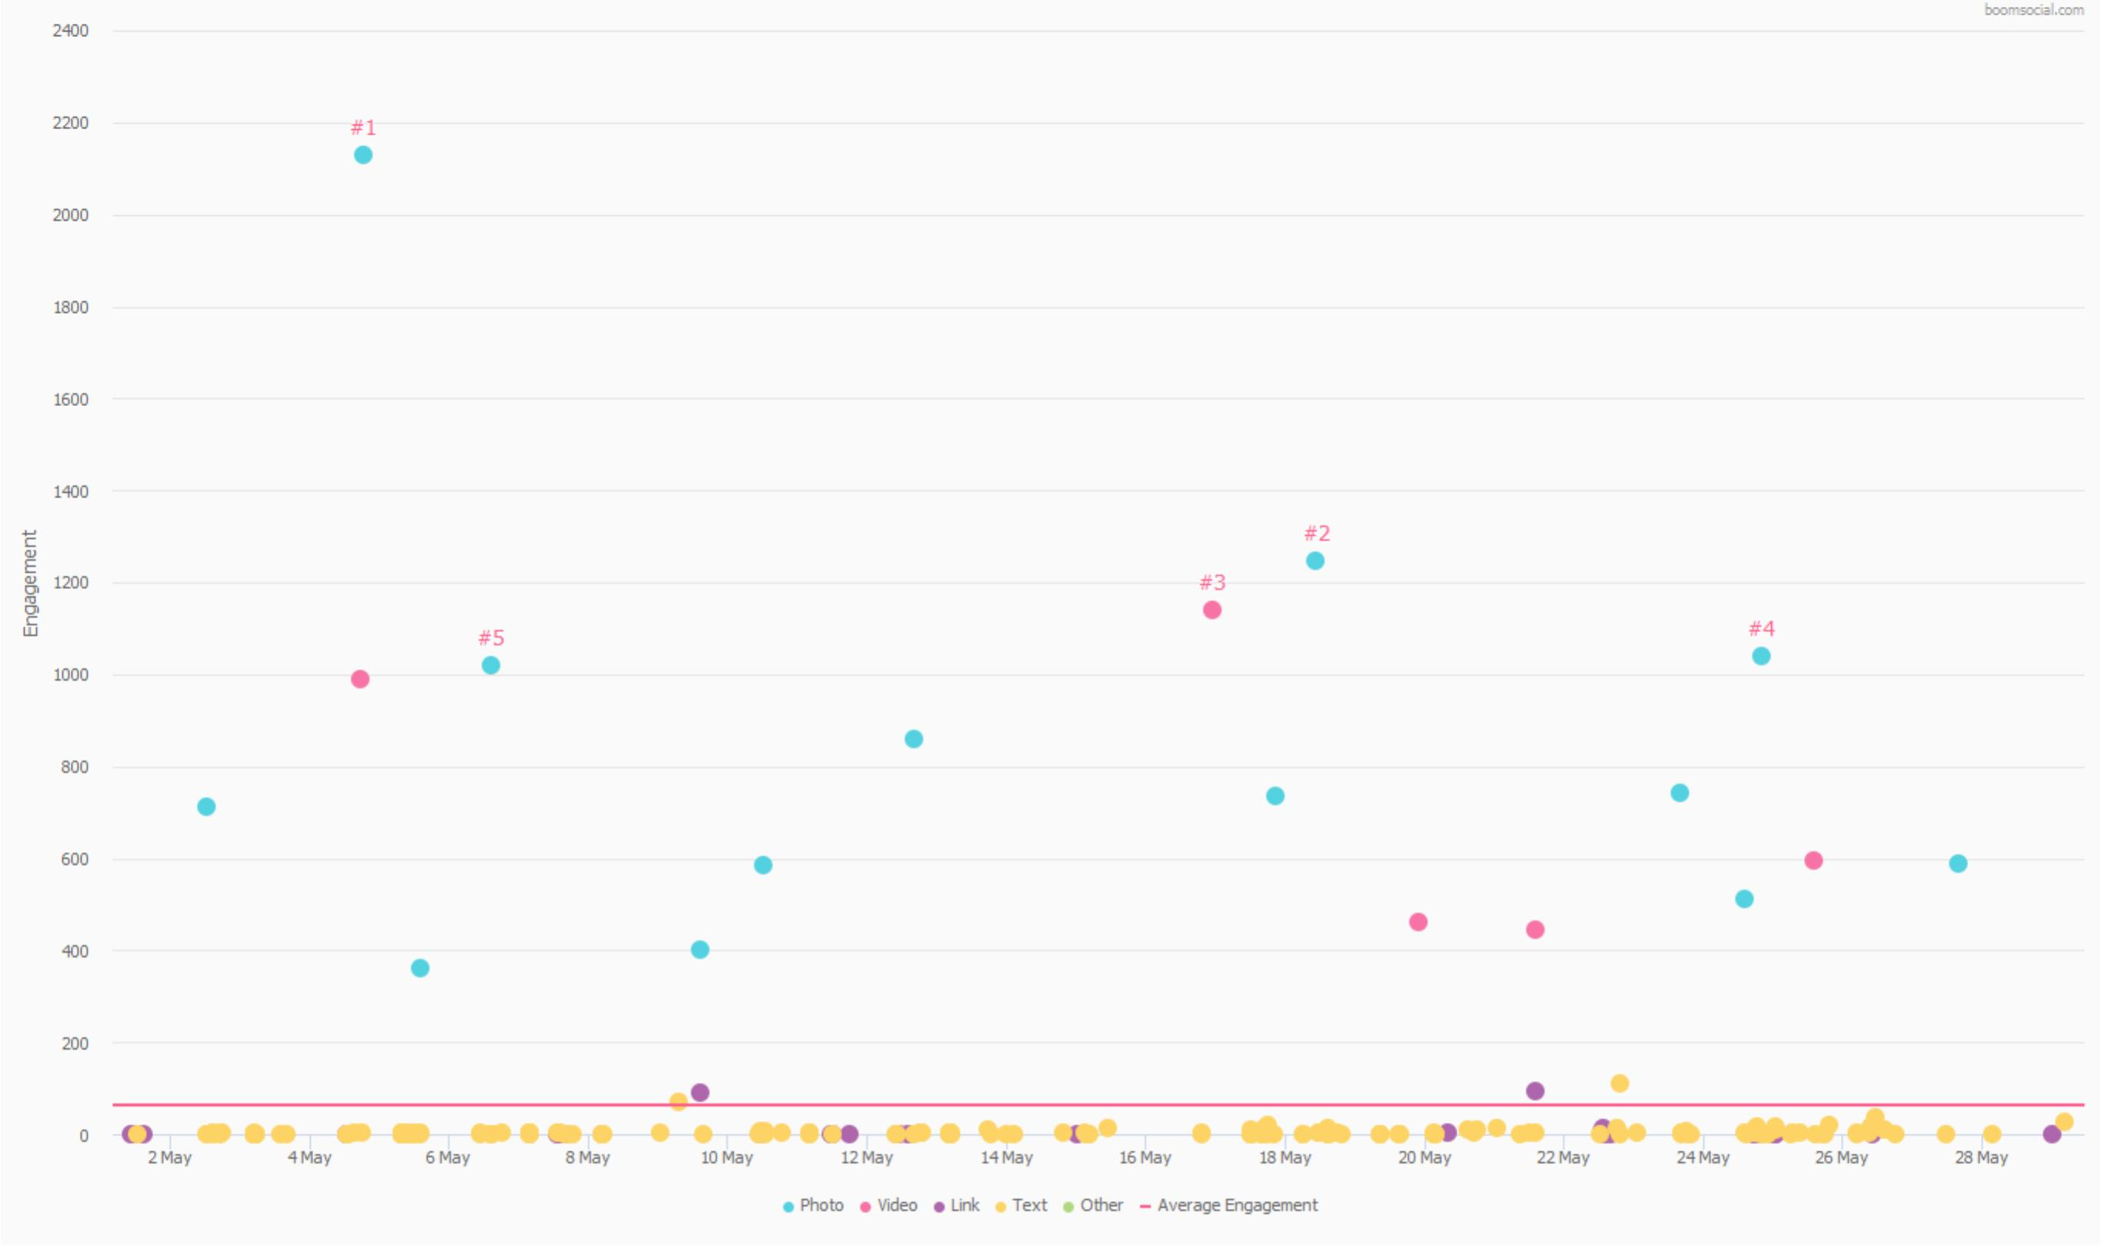
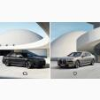
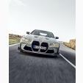
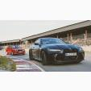
Top Posts
Performance by Date
01.05.2022 – 31.05.2022
Post / Engagement Distribution
Choose your side. #MayThe4thBeWithYou pic.twitter.com/nTaOXma3nc
#1
1.8K
295
%0.128
The new BMW 3 Series. With BMW Curved Display and revised touch-control surfaces, for a digitally enhanced focus on the...
#2
1.1K
141
%0.070
Coming soon. The new #BMW 3 Series. #THE3 pic.twitter.com/ZkMyrgYDnk
#3
993
146
%0.067
The new M4 CSL in numbers ⏬ 550hp 3.7s - 0-100 km/h 10.7 - 0-200 km/h + 40hp over M4 Competition Coupé 100kg less...
#4
915
126
%0.060
Pure power with a personal touch. The limited edition BMW M4 Competition Coupé x KITH. #THEM4 __ The #BMW M4...
#5
890
128
%0.059
24

Slide 25
Engagement
The top posts analysis of BMW Twitter account for the most engaging posts, engagement rates, likes, retweets, and engagement patterns in 01 May 2022 - 31 May 2022 period.
14K
1.7K
15K
Total Likes
Total Retweets
Total Engagement
The 246 posts shared by BMW Twitter account in 01.05.2022 – 31.05.2022 period has received 13,736 likes.
The 246 posts shared by BMW Twitter account in 01.05.2022 – 31.05.2022 period has received 1,738 shares.
The 246 posts shared by BMW Twitter account in 01.05.2022 – 31.05.2022 period has received 15,474 engagement.
25

Slide 26
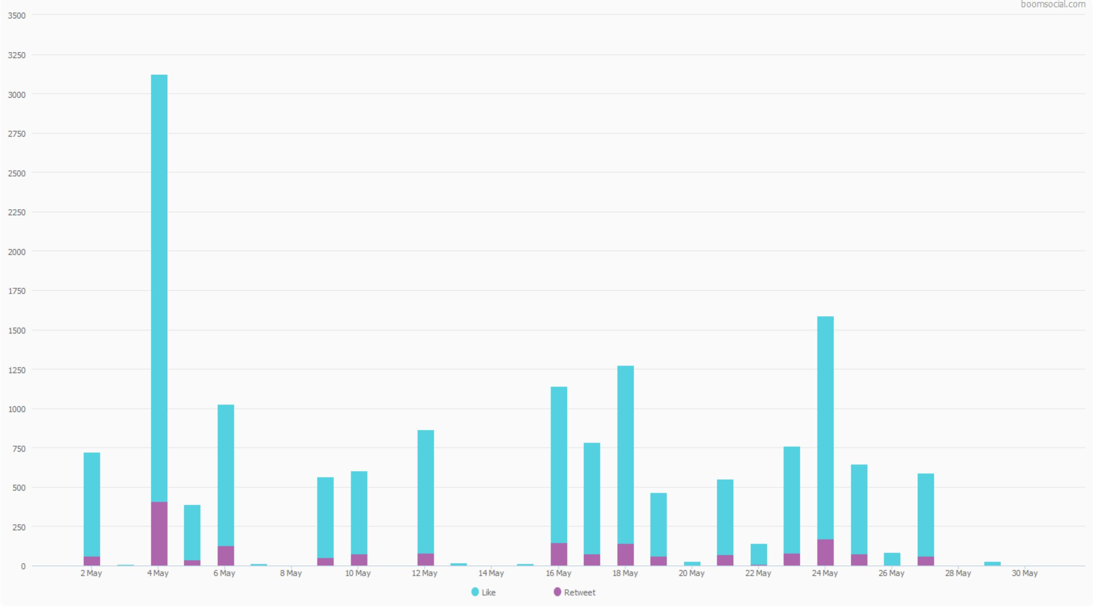
Engagement Analysis
Engagements
01.05.2022 – 31.05.2022
Post Engagement by Day
13,736
Total Likes of the Posts
01.05.2022 – 31.05.2022
1,738
Total Retweets of the Posts
01.05.2022 – 31.05.2022
15,474
Total Engagements of the Posts
01.05.2022 – 31.05.2022
26

Slide 27
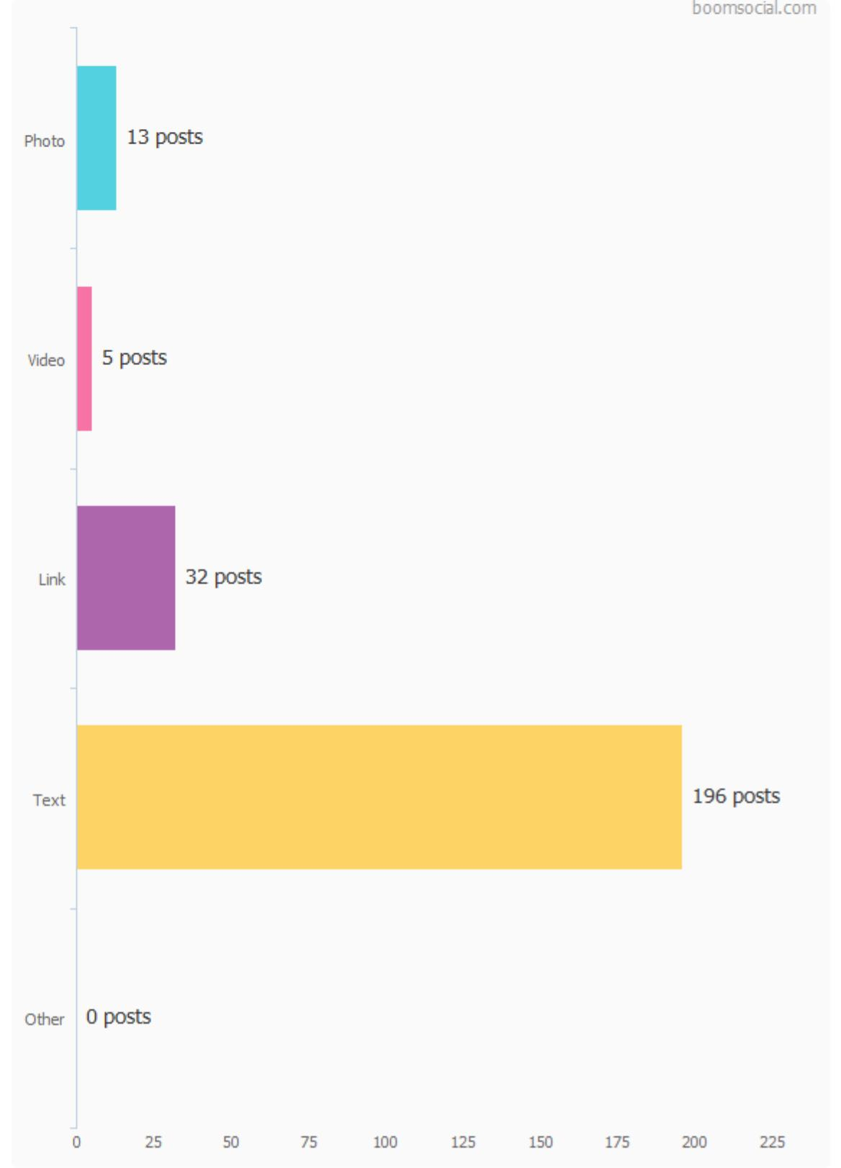
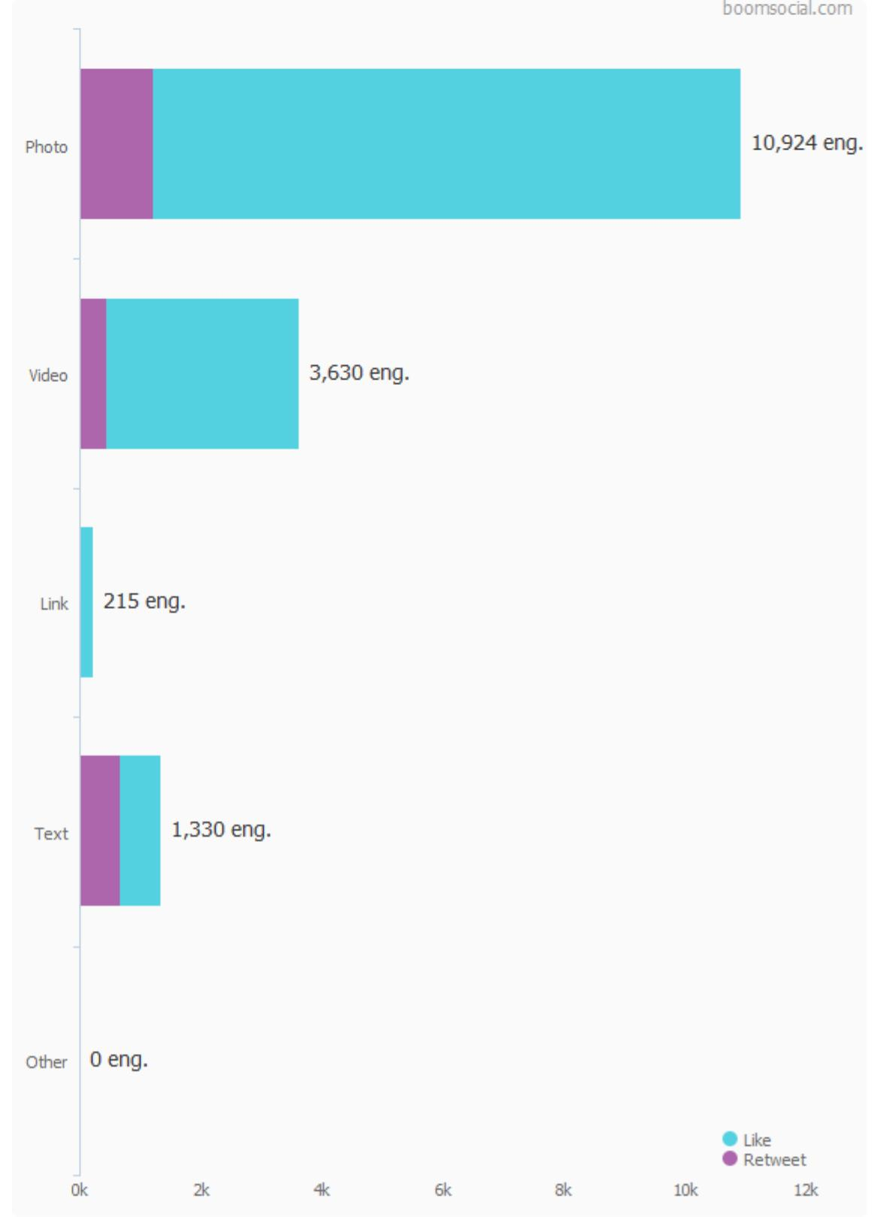
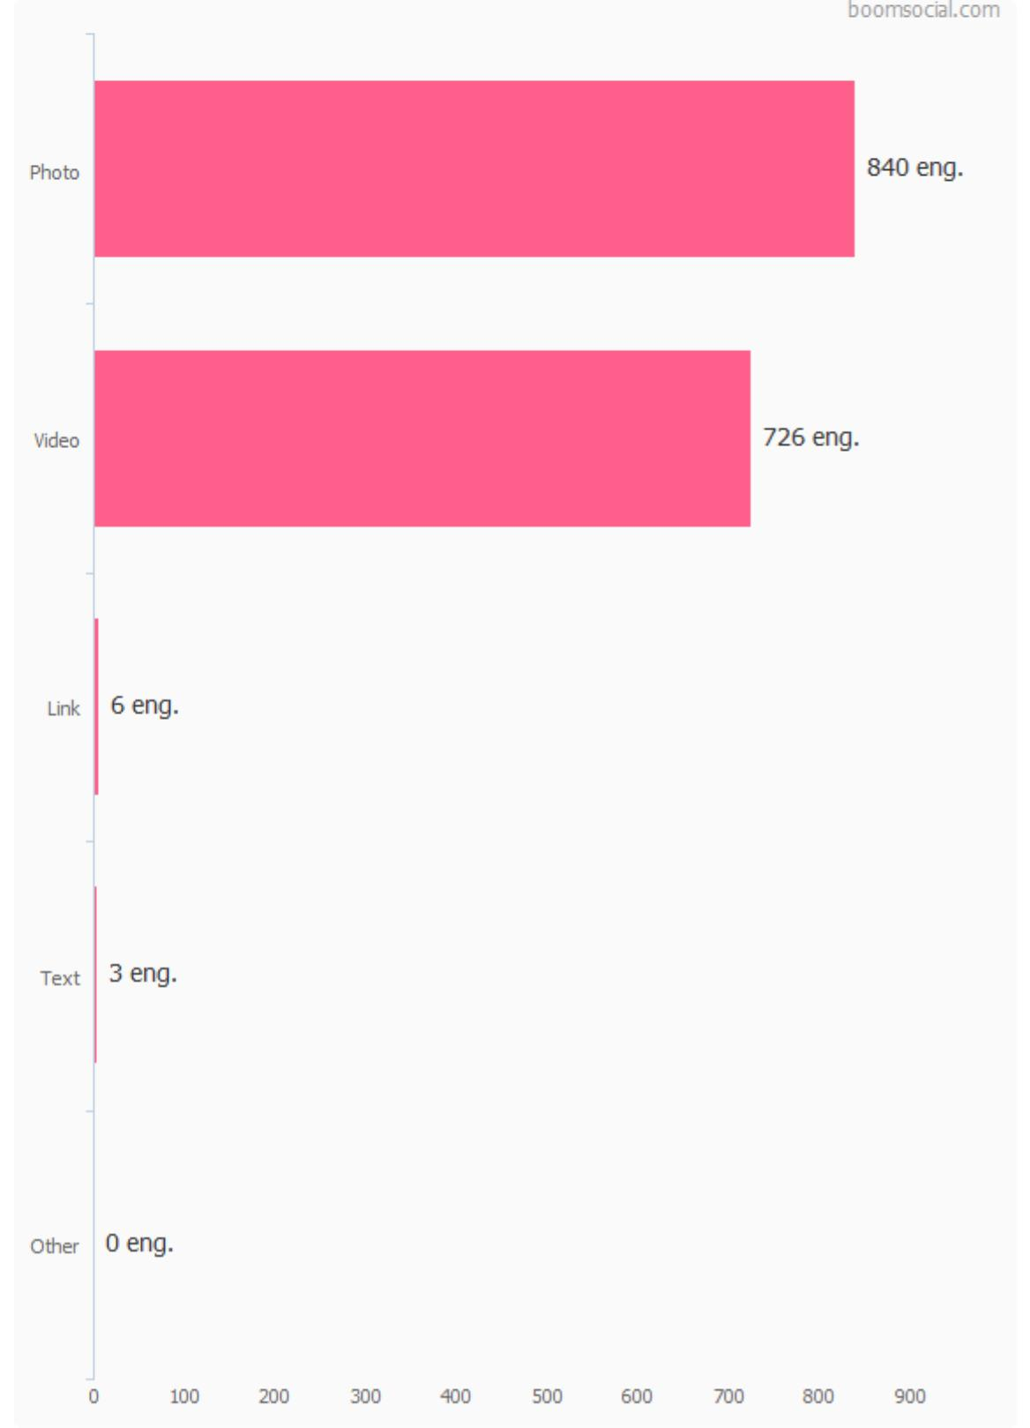
Engagement Analysis
Post Types and Engagement
01.05.2022 – 31.05.2022
Number of Posts by Post Type
Engagement by Post Type
Engagement per Post by Post Type
Number of Posts by Type compares the brand posts with the industry averages. Engagement number is the total of post likes and retweets.
27

Slide 28
Engagement Analysis
Engagement Performance
01.05.2022 – 31.05.2022
Total Engagement vs Industry
15,474
Brand Total Engagement
4,934.1
Industry Engagement Average
Engagement per Post vs Industry
62.9
Brand Engagement per Post
67.1
Industry Engagement Per Post
28

Slide 29
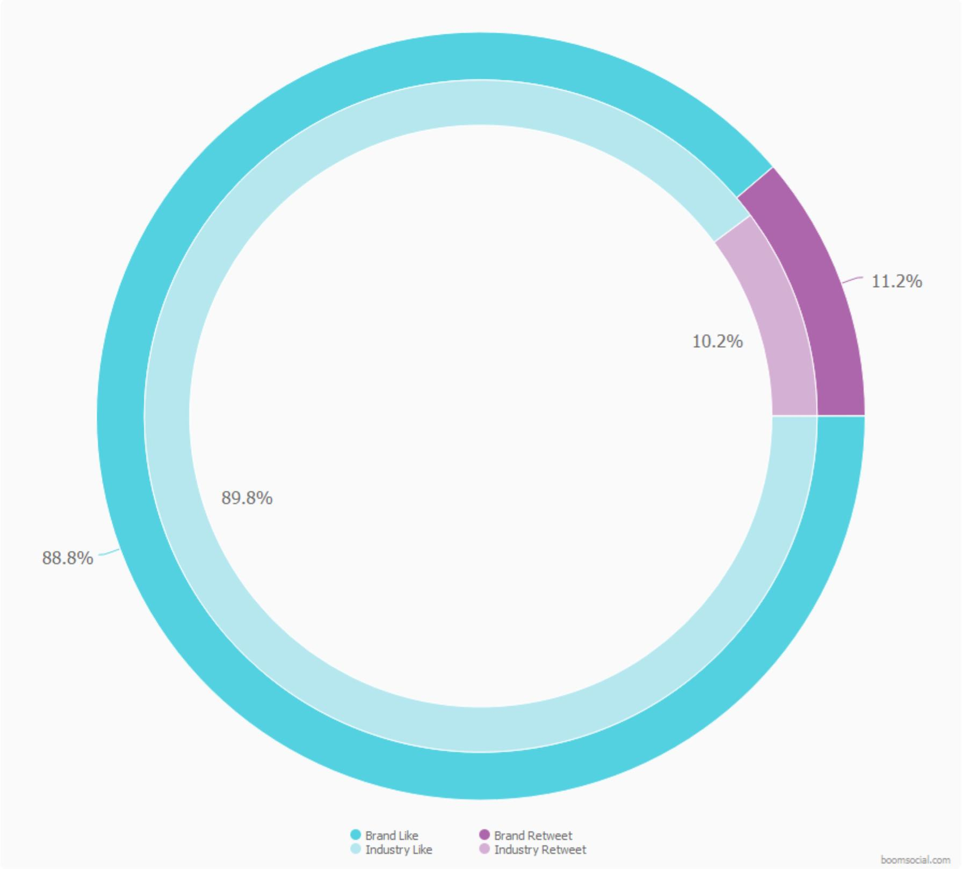
Engagement Performance
Engagement Analysis
01.05.2022 – 31.05.2022
Engagement Types
246
73.6
Total Posts
Industry Avg. Post per Brand
55.8
60.2
Likes per Post
Industry Avg. Likes per Post
7.1
6.8
Retweets per Post
Industry Avg. Retweets per Post
62.9
67.1
Engagement per Post
Industry Avg. Engagement
29

Slide 30
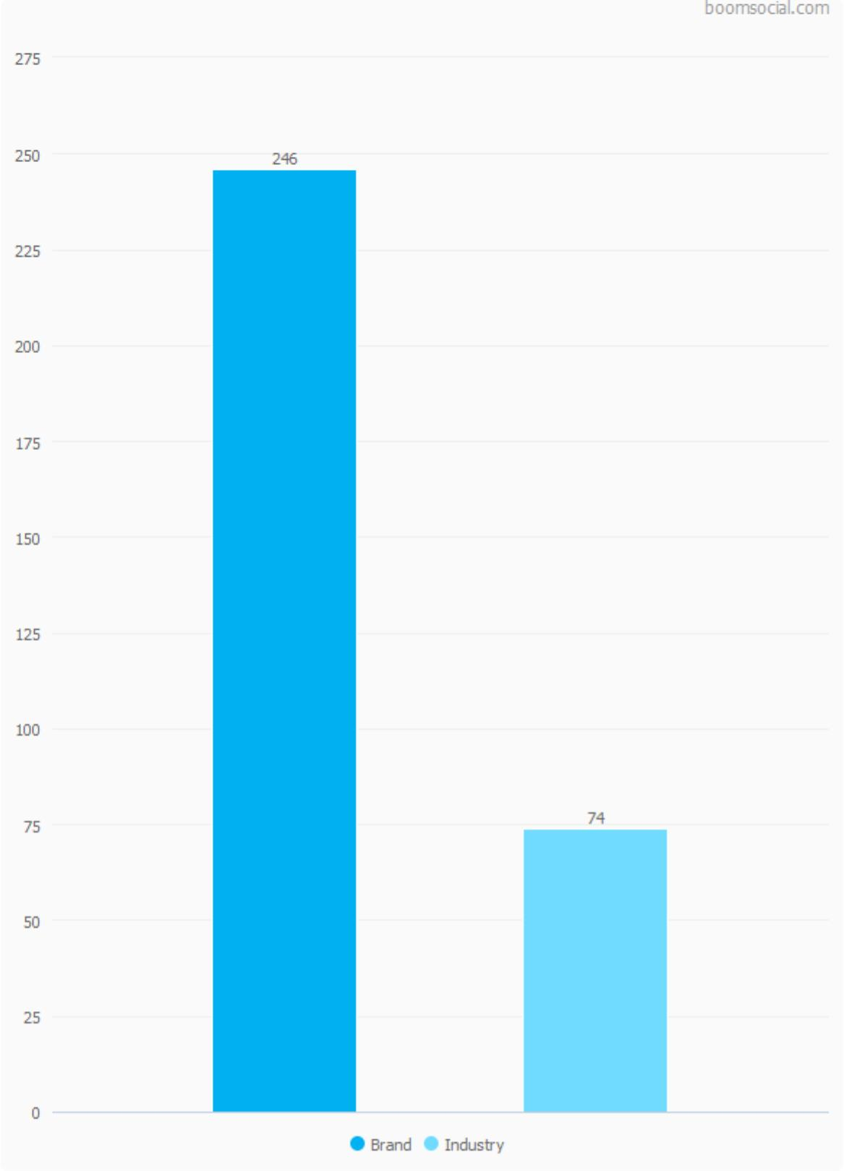
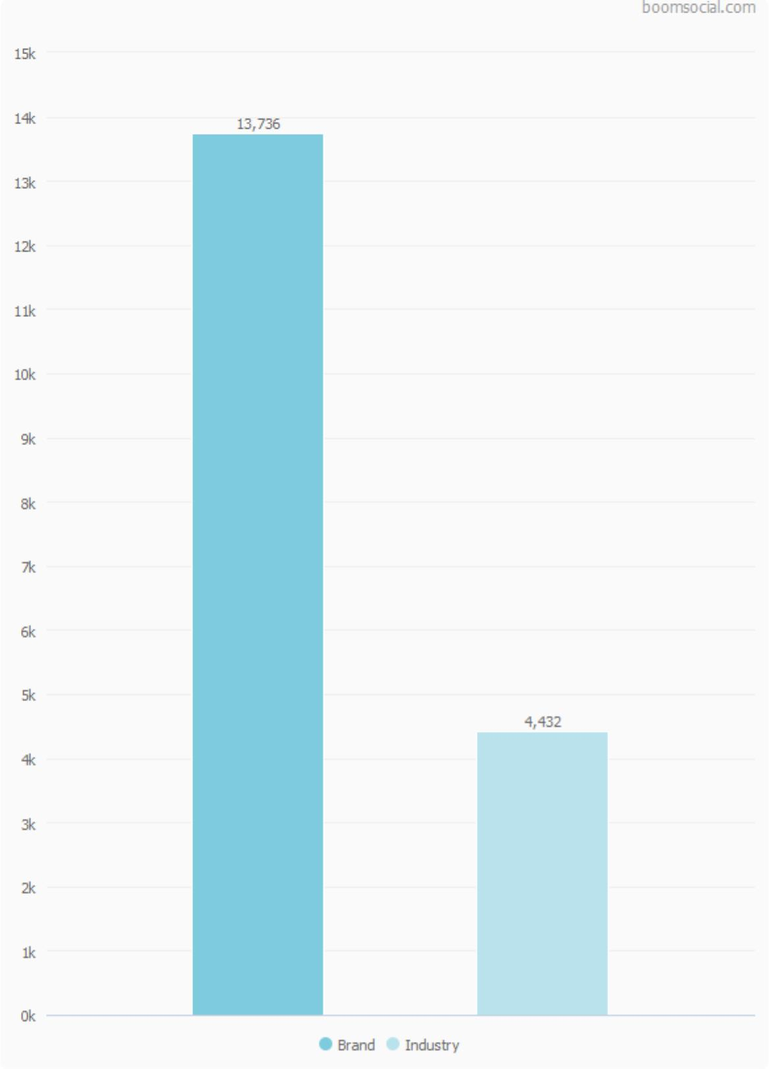
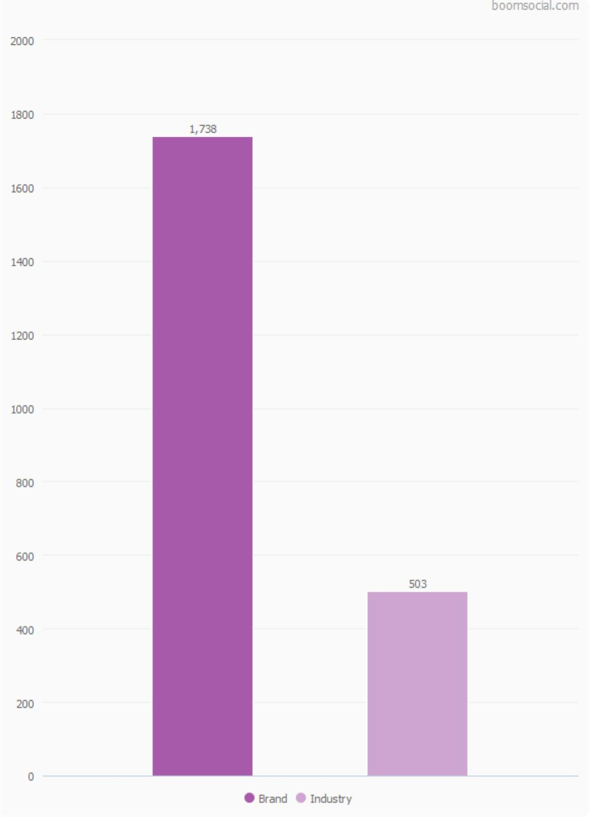
Engagement Analysis
Engagement vs Industry
01.05.2022 – 31.05.2022
Post Count
Post Likes
Post Retweets
30

Slide 31
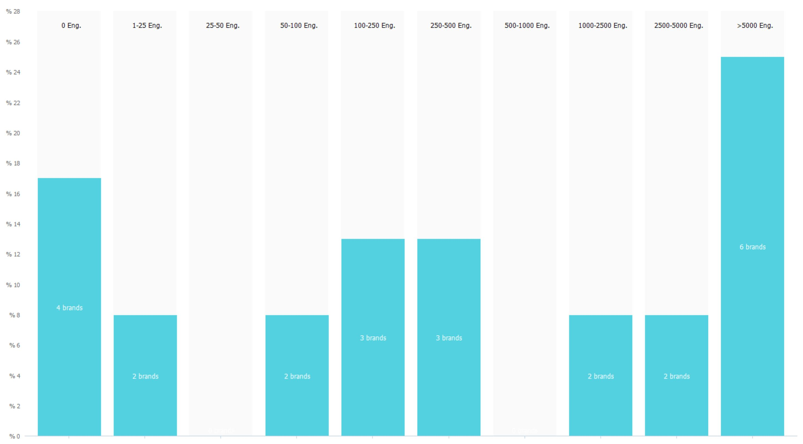
Engagement Analysis
Engagement of the Industry
01.05.2022 – 31.05.2022
Pages in the Industry by Monthly Average Engagement
516
Monthly Average Engagement
for the Brand
01.05.2022 – 31.05.2022
164
Monthly Average Engagement
for the Industry
01.05.2022 – 31.05.2022
Each range shows the number of brands which have 30-day average engagement counts between the limits. Values are adjusted for 30-day period.
31

Slide 32
Brands in the Industry
The comparison of BMW Twitter account with Automotive > Manufacturers industry in 01 May 2022 - 31 May 2022 period.
24
472K
4.9K
Total Brands in Industry
Average Followers
Average Engagement
There were 24 brands in Germany Automotive > Manufacturers industry on 01.05.2022.
The average number of followers for accounts in the industry on 31.05.2022 was 472,089.
The average engagements per brand in 01.05.2022 – 31.05.2022 period was 4,934.1.
32

Slide 33
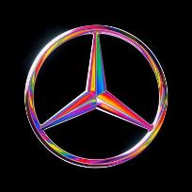
Brands in the Industry
Performance of Industry
01.05.2022 – 31.05.2022
Rank
Brand
Followers
Change
Posts
Likes
Retweets
Engagement
ER
1
Mercedes-Benz
3,890,802
23,676
280
10,183
1,235
11,418
0.001%
2
BMW
2,376,715
18,042
246
13,736
1,738
15,474
0.004%
3
Audi USA
2,103,429
3,587
152
4,839
476
5,315
0.002%
4
Mercedes-AMG
1,619,694
19,679
93
30,956
2,793
33,749
0.028%
5
Audi
613,055
84,213
197
19,875
3,163
23,038
0.027%
6
BMW i
390,290
2,311
62
4,446
525
4,971
0.027%
33

Slide 34
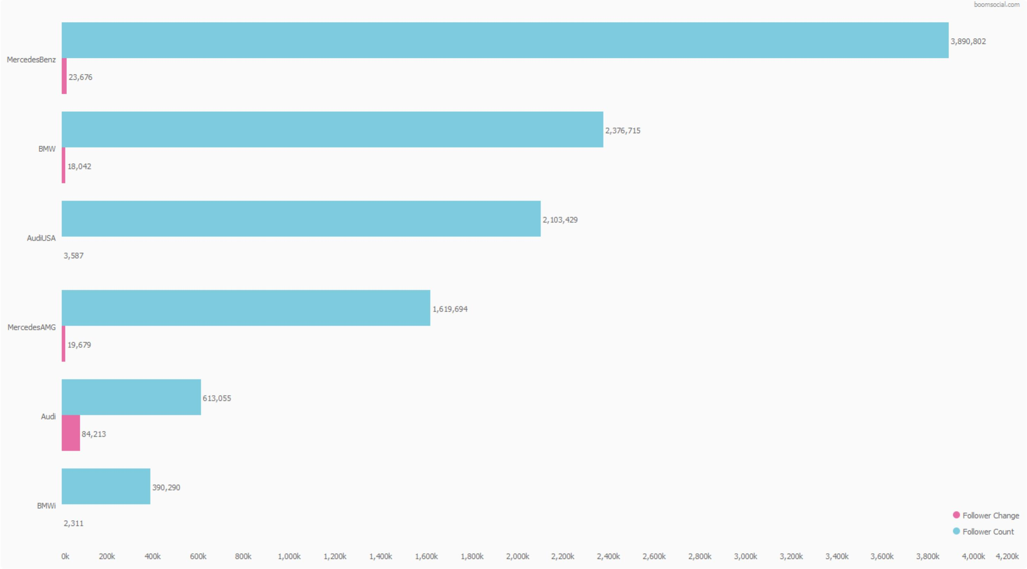
Brands in the Industry
Performance of Brands
01.05.2022 – 31.05.2022
Total Followers and Follower Change
24
On 01.05.2022
Brands in Industry
2,376,715
On 31.05.2022
Total Followers for Brand
472,089
On 31.05.2022
Industry Follower Average
34

Slide 35
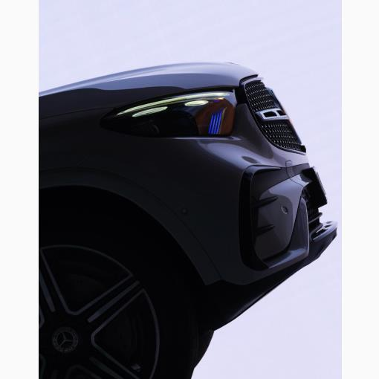
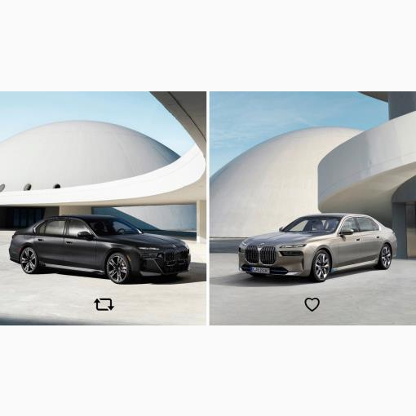
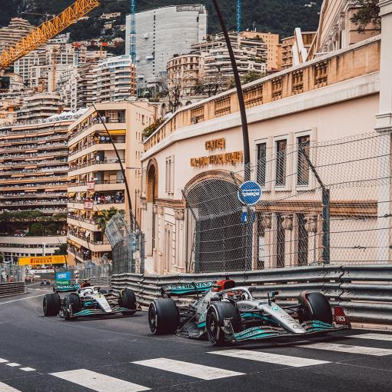
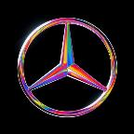
Brands in the Industry
Best Posts of the Industry
01.05.2022 – 31.05.2022
Mercedes-Benz
BMW
Mercedes-AMG
31 May 2022 18:15
04 May 2022 18:22
30 May 2022 15:04
More elegant, more sporty, more to come: experience the GLC World Premiere on June 1st at 5 p.m. CEST. #MercedesBenz #GLC pic.twitter.com/j6Eb809AFn
Choose your side. #MayThe4thBeWithYou pic.twitter.com/nTaOXma3nc
A double-points finish at the #MonacoGP for @MercedesAMGF1 !👊 @GeorgeRussell63 3 was able to gain one position during the race, thus securing P5. @LewisHamilton n was stuck behind a train of cars, crossing the line in P8. Next race: #AzerbaijanGP P! See you in two weeks, Team 🤜...
http://www.twitter.com/MercedesBenz/status/1531655534620950528
http://www.twitter.com/BMW/status/1521872877452242944
http://www.twitter.com/MercedesAMG/status/1531245036020563968
Like
2,377
Like
1,834
Like
1,969
Retweet
151
Retweet
295
Retweet
121
Engagement Rate
%0.077
Engagement Rate
%0.128
Engagement Rate
%0.151
35

Slide 36
Notes and
Descriptions
About the Analysis
BoomSocial brand and industry analyses measures the social media performance of brands using statistical methods and social media data. All statistics in this analysis uses the public data shared by the social media channels.
Follower Count
Page follower counts are determined by the continuous monitoring of the public Twitter follower counts of the relevant social media accounts.
Follower Change
Follower changes are determined by the monitoring of the public Twitter follower counts of the accounts. Daily changes show the difference of the day's final follower count from the previous day's follower count; while monthly change data shows the difference between the last day of the month versus the last day of the previous month.
Post Count
Post counts show the number of different public posts shared on the Twitter account wall, open to public view. Targeted posts, posts shown to specific users or specific groups, or advertising posts which are not on the page wall are not included in the total post counts.
Post Types
Post types show the different post types that are determined by Twitter. All posts which are not classified as photo, video, link, or text are classified as "other".
Engagement
Engagement data shows the total number of engagements from users that are directed to the public Twitter account posts by the relevant account. Engagement and Engagement Count data shows the total number of likes and retweets from users to the post.
Like and Retweet
Like and retweet data shows the total number of engagement in each type for the posts of the account. The data is periodically updated.
Engagement Rate
Post Engagement Rate shows the ratio of total engagements versus the account follower count at the moment the post was shared. Account engagement rates shows the ratio of average likes and retweets per post to the average number of account followers during the period.
Industry Data
Industry data includes the statistical analysis all public account activities of the pages in the industry during the reporting period.
SocialBrands
SocialBrands scores are calculated monthly by the statistical analysis of all activities for all brand accounts in Twitter, using the SocialBrands algorithm. To learn more about SocialBrands and see the results for all industries, please visit www.socialbrands.org website.
36

Slide 37
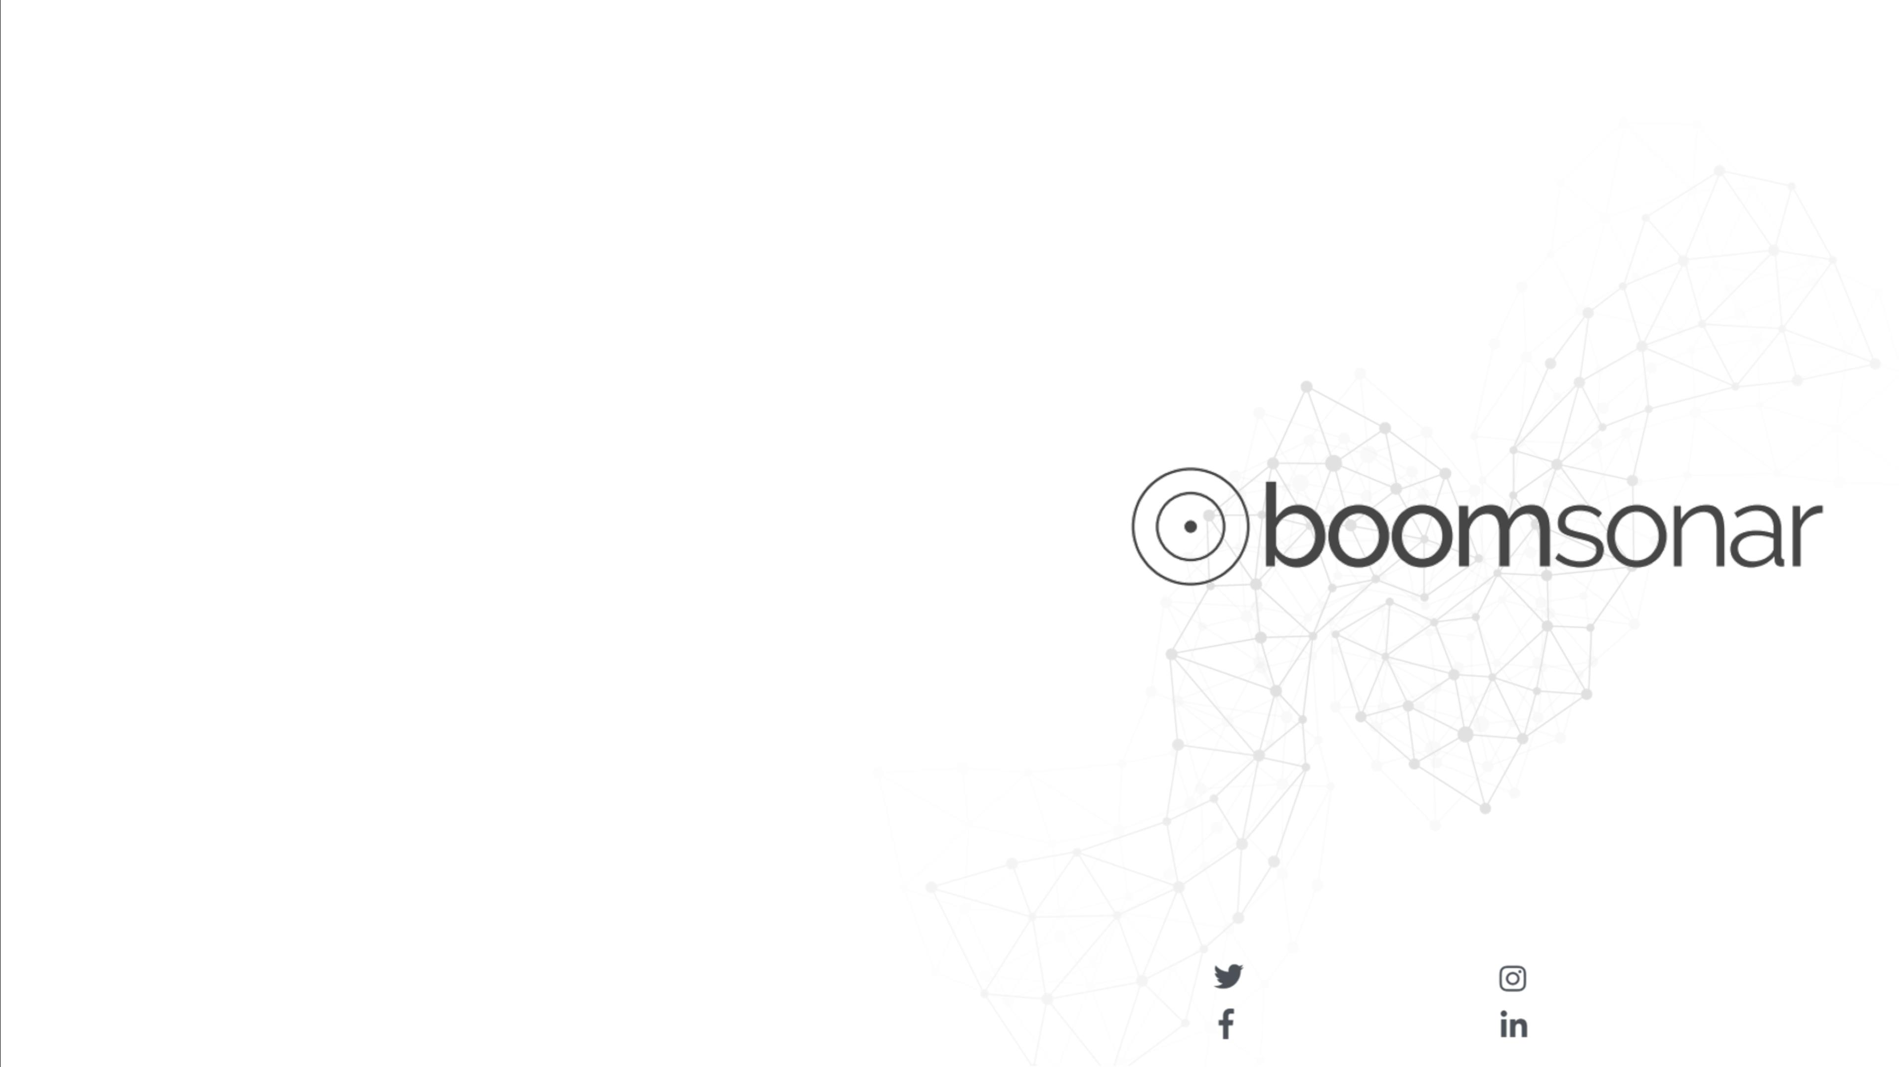
For
More…
Web and Social Media
Business Intelligence Platform
Listen to what gets people talking, analyze the news, reveal insights, see the upcoming trends, make your voice heard, and drive your business to success. From data acquisition to publishing, BoomSonar Suite is the ultimate web & social media business platform.
* Monitor millions of websites and all social media channels in real-time, analyze results, and reach to the unlimited potential of big data.
* Use your social media accounts effectively, tell your story and create a conversation.
* Interact with your customers, answer their questions, solve problems, and keep them happy!
* Analyze the threats to your online reputation, take down fake accounts.
* Prepare benchmarks with powerful social media analytics data of your brand, competitors & industry.
* Create stunning interactive dashboards, see the trends, analyze the results, and find actionable insights.
* Gain deeper insights, find sales opportunities, create business value with machine learning.
* Tell your story with 1-to-1 previews, post scheduling, and multi-channel posting.
Contact us to try BoomSonar Suite!
www.boomsonar.com
sonar@boomsonar.com
(90) 212 293 8000
@BoomSonarSuite
@socialmediamonitoring
/BoomSonarSuite
/socialmediamonitoring
37

Slide 38
TICK TOCK BOOM DIGITAL PR & MARKETING © 2022
contact@boomsocial.com
(+90) 212 293 8000
BoomSocial
BoomSonar
Trendweek
http://www.boomsocial.com
http://www.boomsonar.com
http://www.trendweek.com
Twitter
Facebook
LinkedIn
http://twitter.com/ttboom
http://www.facebook.com/TickTockBoom
http://www.linkedin.com/company/ticktockboom

