Slide 1
BoomSocial
BMW UK Facebook Report
01.09.2015 - 30.09.2015

Slide 2
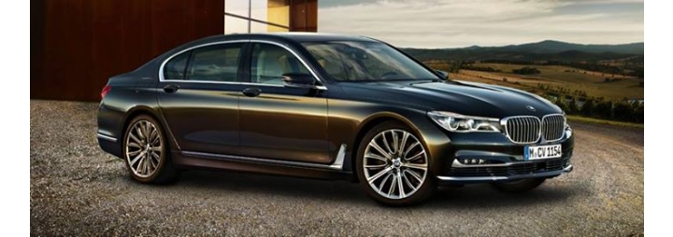
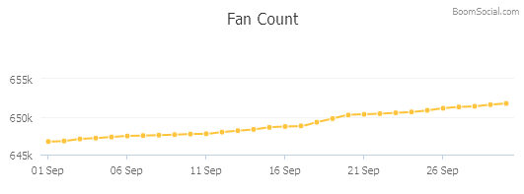
01.09.2015 - 30.09.2015
BMW UK 651.748 Fans · 5.249 People Talking About This
18 BQS
BMW UK Facebook fan page in United Kingdom > Automotive > Manufacturers sector has gained 5.028 fans, and grown from 646.720 to 651.748 fans in 01.09.2015 - 30.09.2015 period. During this period, the page has shared 34 posts and received 31.673 likes, 1.854 comments and 3.820 shares.
https://www.facebook.com/bmwuk
The statistics from this analysis were taken from the publicly-open data shared by Facebook. All rights of this analysis belongs to TTBOOM Digital Interactive Media AS. This analysis cannot be copied, published or distributed completely or partially without permission.
2

Slide 3
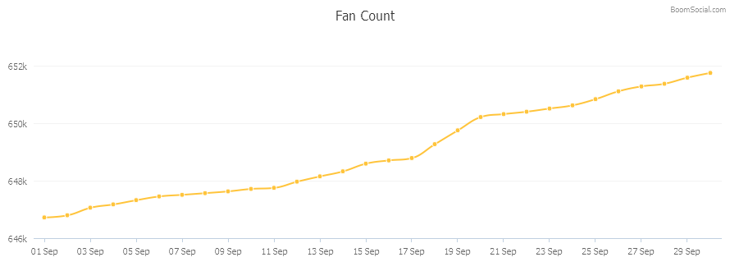
Fan Analysis
01.09.2015 - 30.09.2015
Total Fan Count On 30.09.2015 651.748
Total Fan Growth 01.09.2015 - 30.09.2015 5.028
Average Daily Growth 01.09.2015 - 30.09.2015 168
3

Slide 4
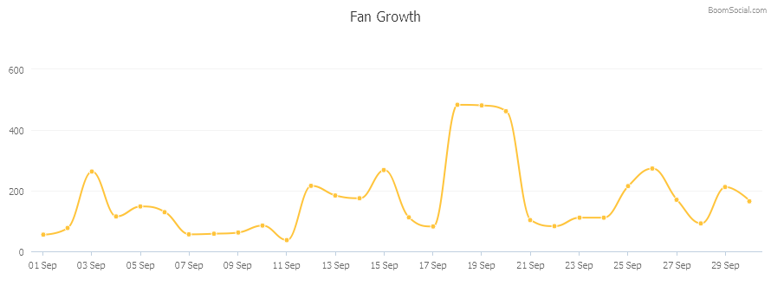
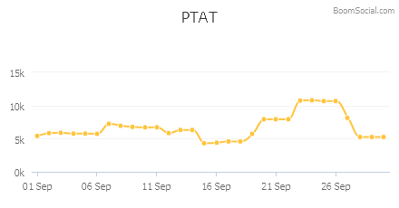
Fan Growth and PTAT
01.09.2015 - 30.09.2015
Highest Daily Growth 01.09.2015 - 30.09.2015 483 (18.09.2015)
People Talking About This On 30.09.2015 5.249
People Talking About This (PTAT) value is calculated by Facebook. This value shows the number of people who have interacted with the page in the last seven days.
4

Slide 5
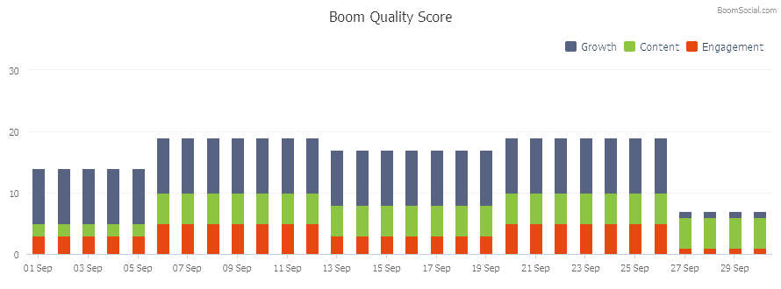
Boom Quality Score
01.09.2015 - 30.09.2015
In 01.09.2015 - 30.09.2015 period, the average BQS score of the page was 16,1. The page had an average BQS Growth Score of 7,9/10, BQS Content Score of 4,5/10 and BQS Engagement Score of 3,7/10.
Growth 7,9/10
Content 4,5/10
Engagement 3,7/10
Boom Quality Score (BQS), is a metric measuring the fan growth, content usage and post engagement of brands with a maximum score of 30.
5

Slide 6
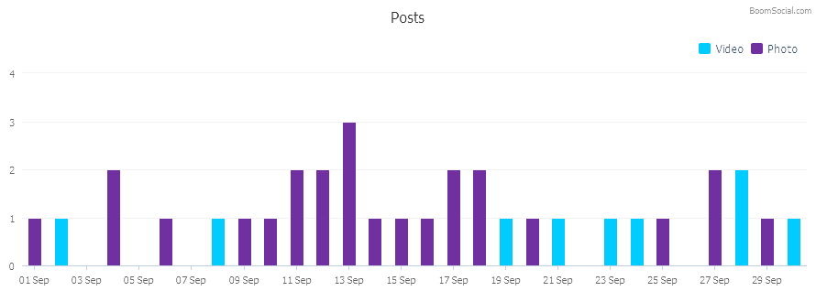
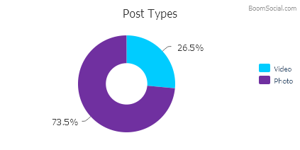
Posts
01.09.2015 - 30.09.2015
Total Posts by Page 01.09.2015 - 30.09.2015 34
Most Used Post Type 01.09.2015 - 30.09.2015 Photo (25 posts)
Post types are determined by Facebook. Only posts by page admin are included, user posts to open walls are excluded.
6

Slide 7
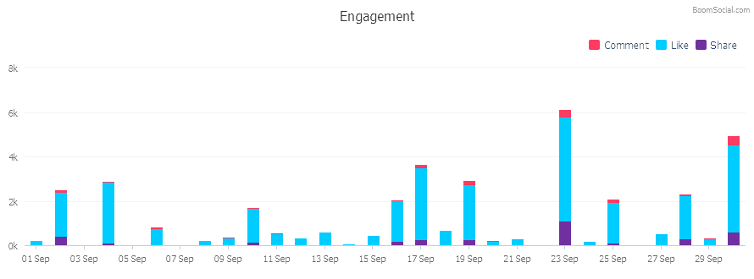
Engagement
01.09.2015 - 30.09.2015
Total Likes 01.09.2015 - 30.09.2015 31.673
Total Comments 01.09.2015 - 30.09.2015 1.854
Total Shares 01.09.2015 - 30.09.2015 3.820
Most Engaging Content Type 01.09.2015 - 30.09.2015 Photo
Most Engaging Content Type is the content type that has the highest total of interactions (likes, comments and shares).
7

Slide 8
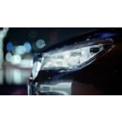
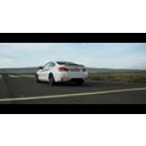
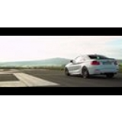
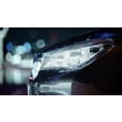
Top 10 Posts by Engagement
01.09.2015 - 30.09.2015
Like
Comment
Share
Engagement Count
BMW UK 23.09.2015 07:45 The new BMW 7 Series: power at your fingertips. http://po.st/yHvvkV »
4.695
341
1.113
6.149
BMW UK 30.09.2015 08:26 Turn the speakers up, you're going to want to hear this. Find out more about BMW M Performance accessories now: http://po.st/Ds5c4g »
3.922
451
596
4.969
BMW UK 19.09.2015 10:00 Music to your ears. Find out more about BMW M Performance accessories now: http://po.st/Ds5c4g »
2.482
183
277
2.942
BMW UK 02.09.2015 07:49 Knowledge truly is power. This is the new BMW 7 Series: http://po.st/yHvvkV »
1.996
113
408
2.517
BMW UK 17.09.2015 08:00 Timeline Photos BMW are giving one lucky fan the chance to drive the official vehicle of England Rugby, the BMW X5, for a whole year - as well... »
2.416
138
212
2.766
The posts are listed by the total number of interactions (likes, comments and shares).
8

Slide 9
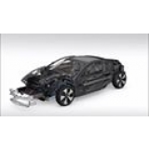
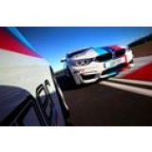
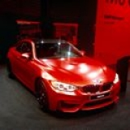
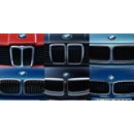
Top 10 Posts by Engagement
01.09.2015 - 30.09.2015
Like
Comment
Share
Engagement Count
BMW UK 28.09.2015 08:03 The game has changed. Discover the BMW i8: www.becomeelectric.co.uk #BecomeElectric »
1.888
103
291
2.282
BMW UK 04.09.2015 16:00 Timeline Photos Drive six exceptional cars, including the BMW M4, in one day. Enter now to be one of eight winners driving at PalmerSport: htt... »
2.616
45
111
2.772
BMW UK 16.09.2015 12:57 Timeline Photos Technology-driven, adrenaline-fuelled. The stunning #BMW #M4 on show in Frankfurt. #FrankfurtMotorShow »
1.821
41
188
2.050
BMW UK 25.09.2015 08:35 Timeline Photos BMW are giving one lucky fan the chance to drive the official vehicle of England Rugby, the BMW X5, for a whole year - as well... »
1.815
158
132
2.105
BMW UK 10.09.2015 10:20 Timeline Photos Celebrating 40 years of the #BMW #3Series: The evolution of the kidney grille. #TBT »
1.525
41
136
1.702
The posts are listed by the total number of interactions (likes, comments and shares).
9

Slide 10
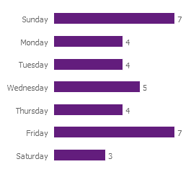
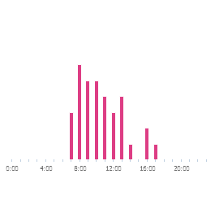
Post Time Analysis
01.09.2015 - 30.09.2015
0:00
1:00
2:00
3:00
4:00
5:00
6:00
7:00
8:00
9:00
10:00
11:00
12:00
13:00
14:00
15:00
16:00
17:00
18:00
19:00
20:00
21:00
22:00
23:00
Sunday
Monday
Tuesday
Wednesday
Thursday
Friday
Saturday
Posts by Days
Posts by Hours
Most Active Hours
08:00 6 Posts
09:00 5 Posts
10:00 5 Posts
The day and time of the posts were calculated from the time of each post from the pages in the sector. Most active day and hour was used as a maximum point, and divided to 7. Each day and hour is then assigned by the post count, and colored accordingly. All days and times are at UTC+0.
10

Slide 11
TICK TOCK BOOM DIGITAL PR & MARKETING © 2014 contact@boomsocial.com (90)212 293 8000
BoomSocial http://www.boomsocial.com
BoomSonar http://www.boomsonar.com
Trendweek http://www.trendweek.com
Twitter http://twitter.com/ttboom
Facebook http://www.facebook.com/TickTockBoomFans
Linkedin http://www.linkedin.com/company/ticktockboom

